Slide 1

人工智能编程实践
授课教师：饶云波
电子科技大学 · 信息与软件工程学院
电子科技大学，中国⋅成都，2024年4月1日

Slide 2
Python Language Overview
Python Language Overview
English /ˈpaɪθən/, American /ˈpaɪθɑːn/
is an interpreted, object-oriented programming language
is an open source language with a large number of libraries for efficient development of various applications
Features of the Python language
Simple, high-level, object-oriented, extensible, free and open source, portable, rich library, embeddable
Python language applications
Operating systems administration,
Scientific computing,
Web applications,
Graphical user interface (GUI) development,
Other (Game Development, etc.)

Slide 3
Python Versions
Python Language Versions and Development Environments
Python major versions: Python 2 and Python 3
Commonly used Python implementations:
Cpython, Jython, IronPython, PyPy
Integrated Development Environment for the Python
IDLE (built-in)
Spyder
PyCharm
Eclipse + Pydev plugin
Visual Studio + Python Tools for Visual Studio,
PythonWin

Slide 4
Anaconda install
Anaconda install

Slide 5
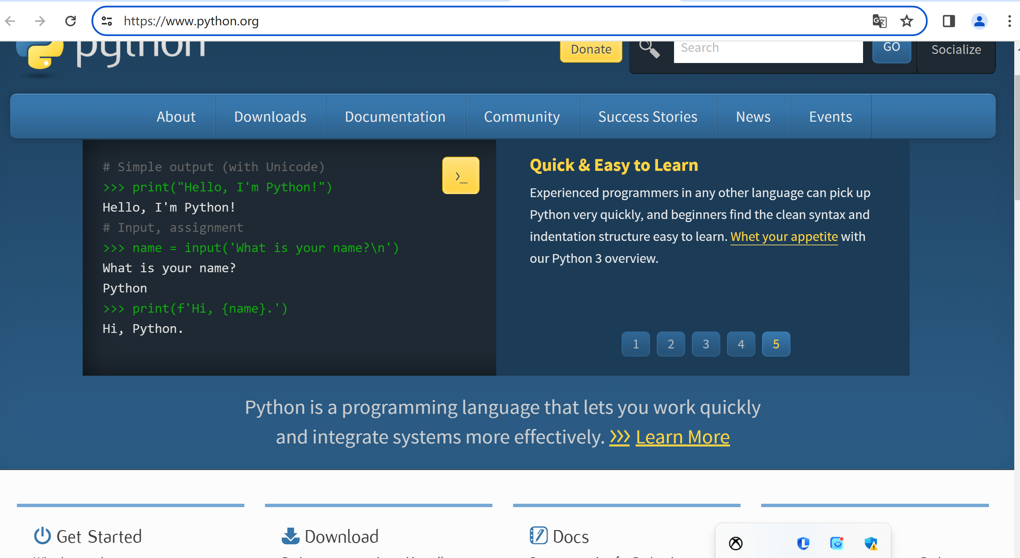
Python study
https://www.python.org

Slide 6

Anaconda install
https://www.anaconda.com/

Slide 7
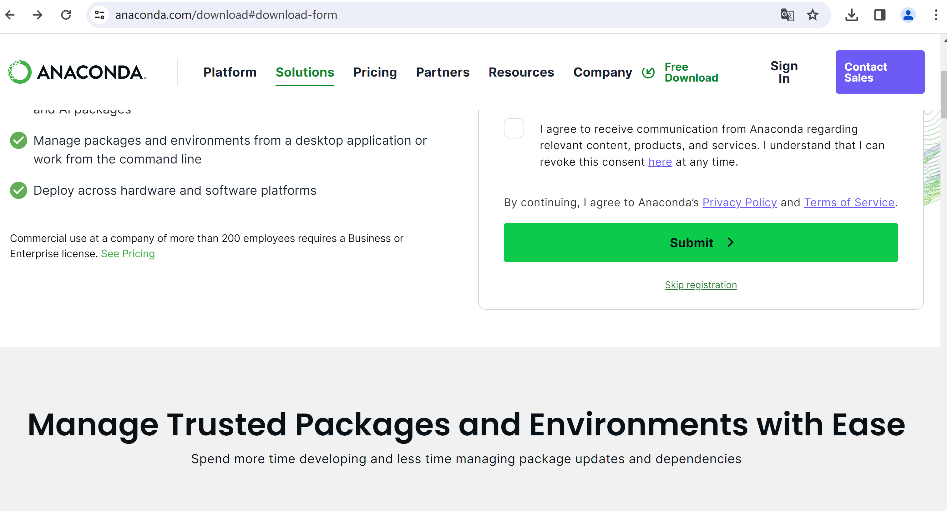
Anaconda install
Click here!

Slide 8
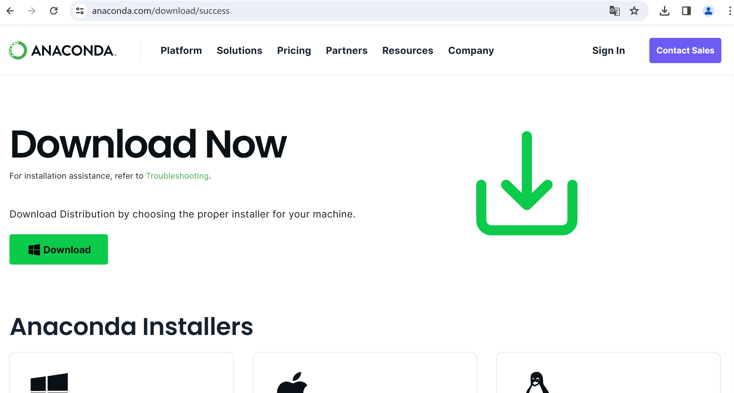
Anaconda install
Click here!
Click here!

Slide 9
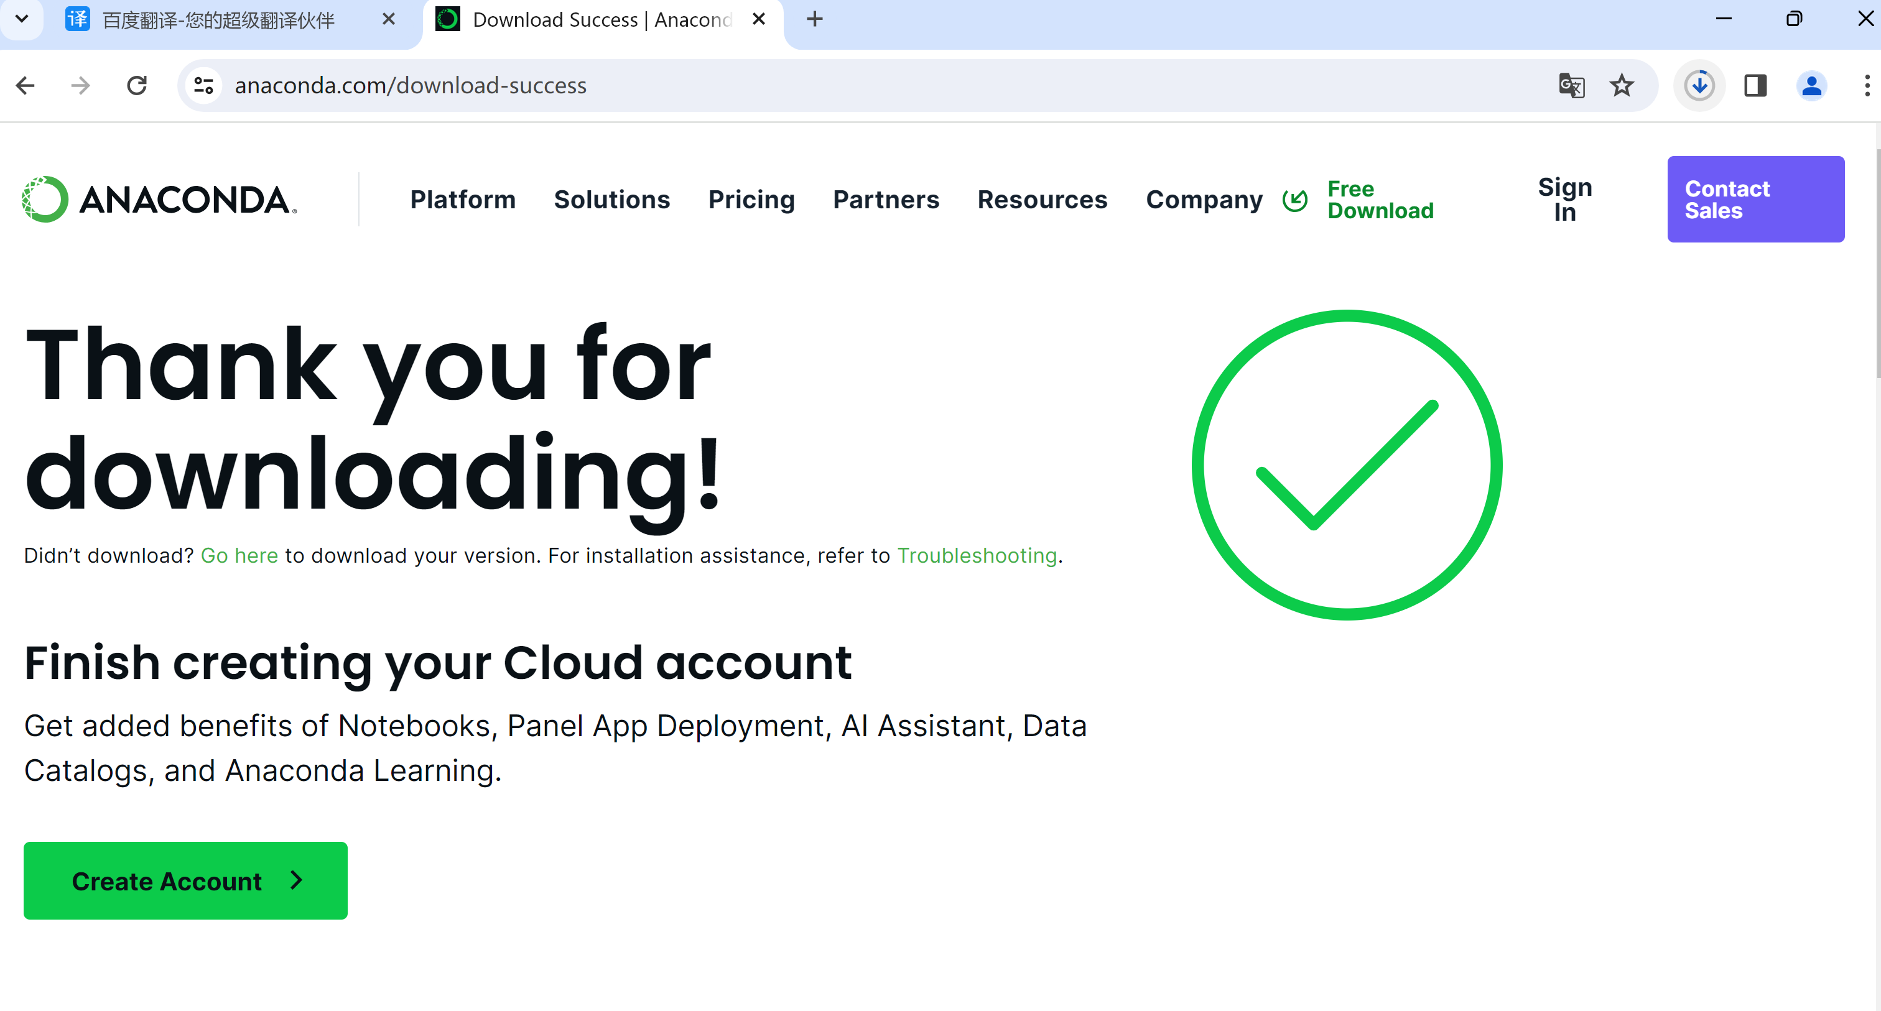
Anaconda install

Slide 10
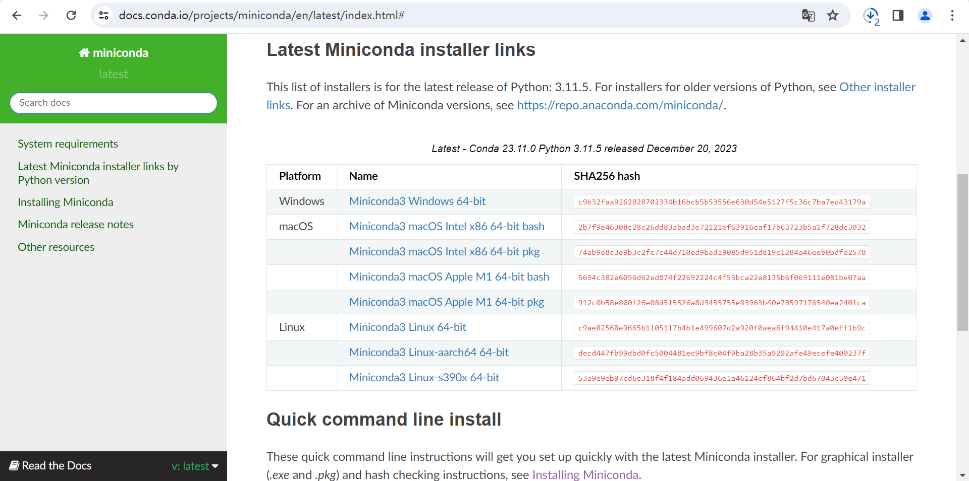
Anaconda install
https://docs.conda.io/projects/miniconda/en/latest/index.html#

Slide 11
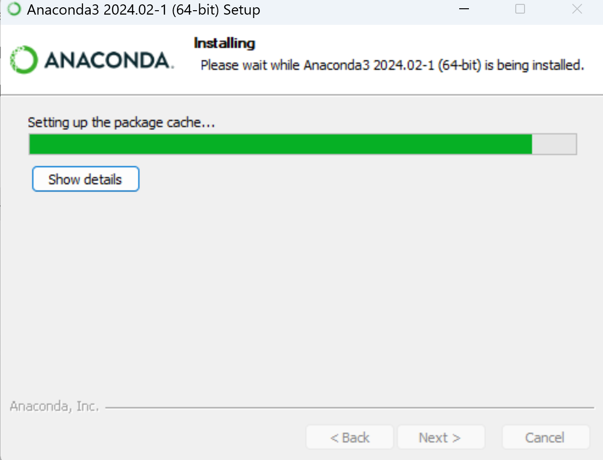
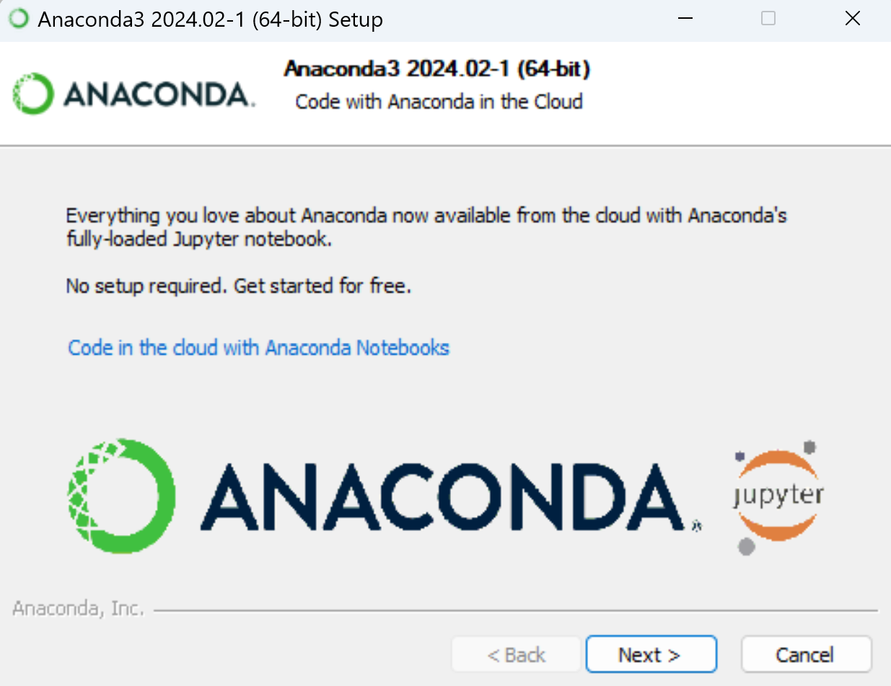
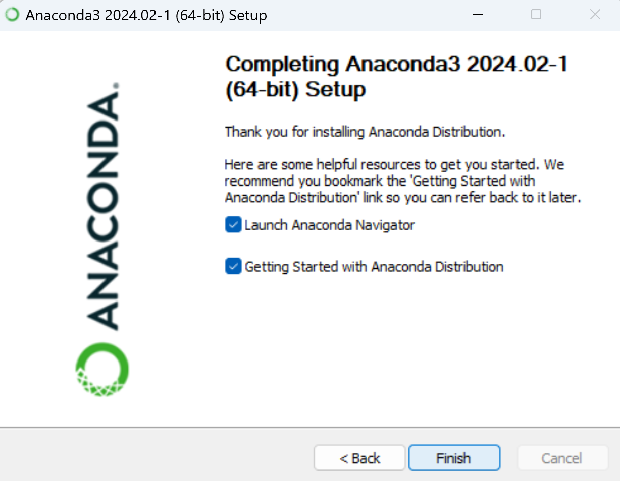
Anaconda install

Slide 12
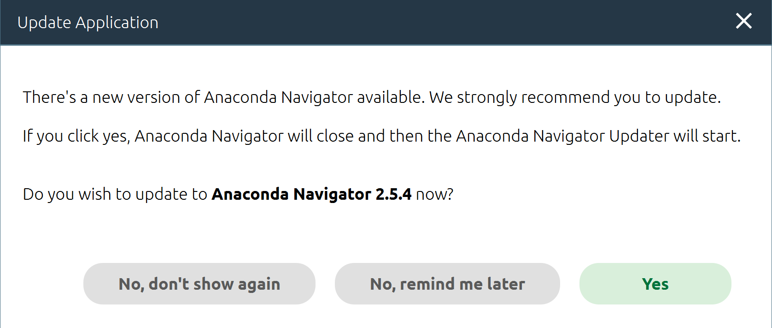
Anaconda install

Slide 13
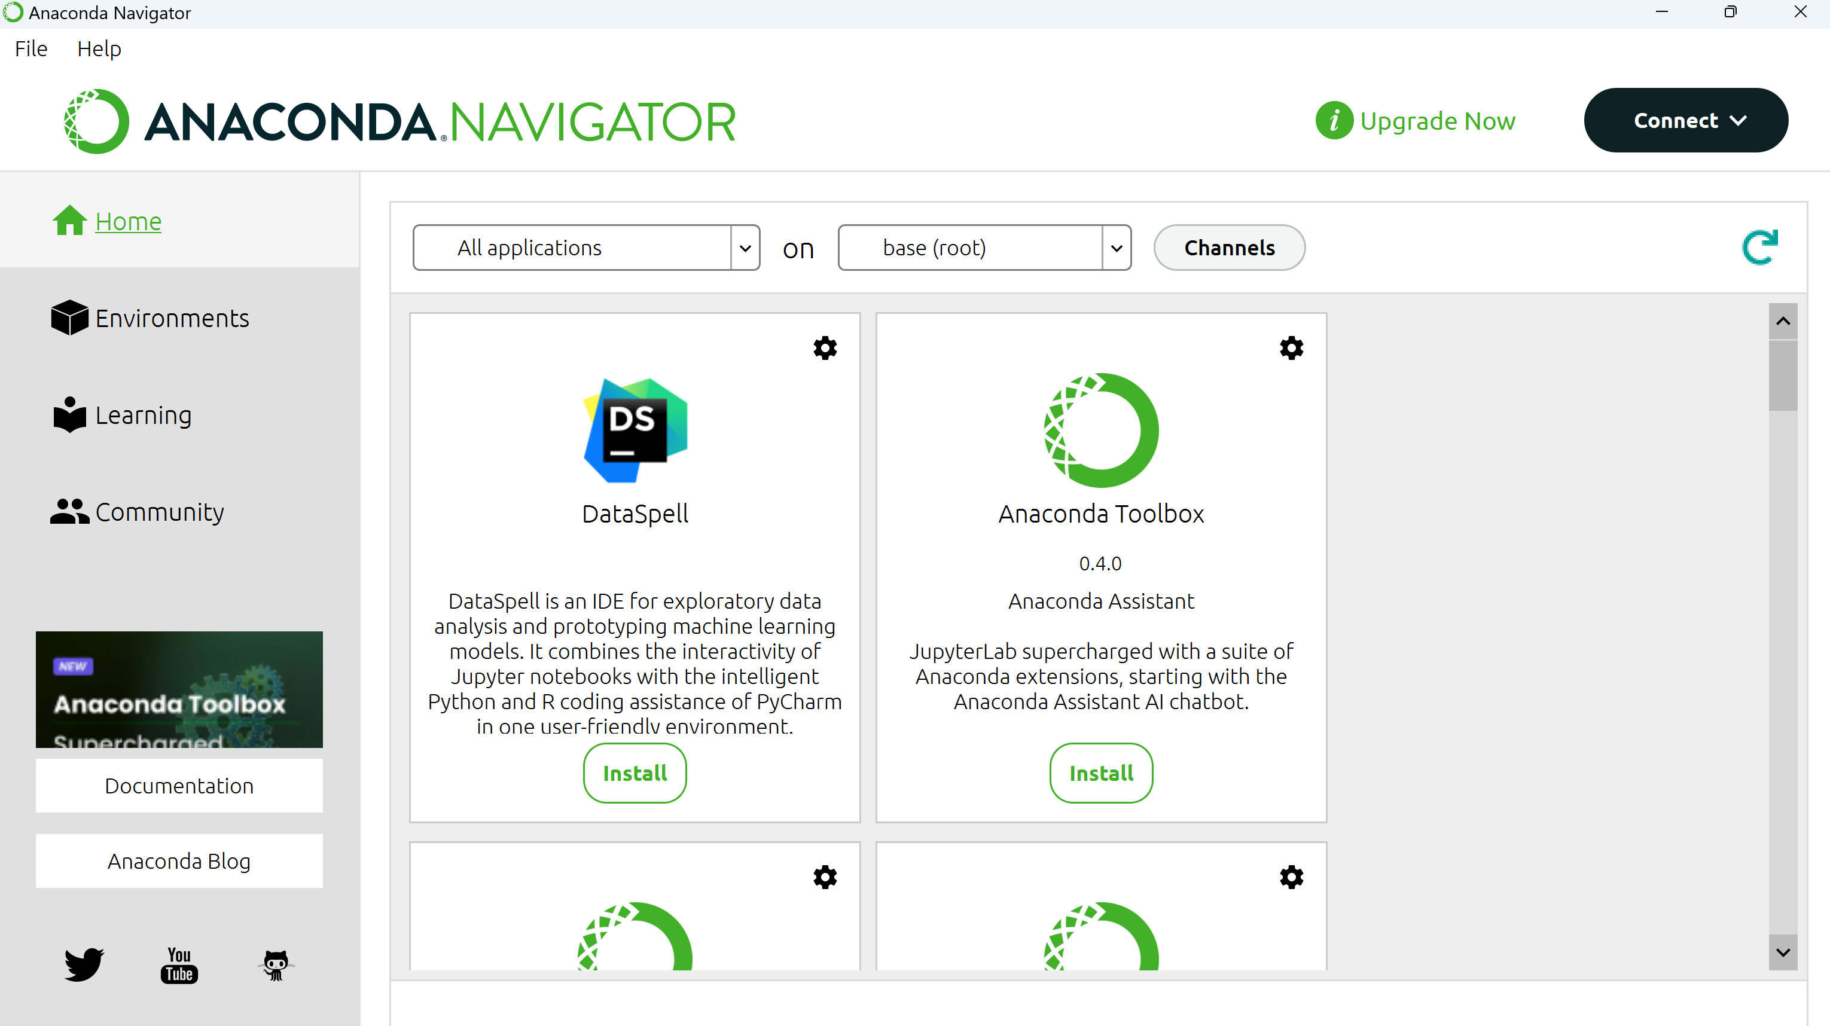
Anaconda install

Slide 14
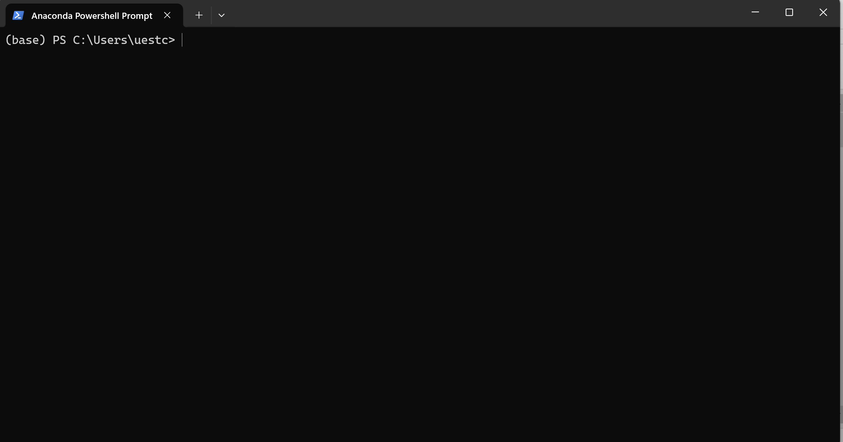
Anaconda install

Slide 15
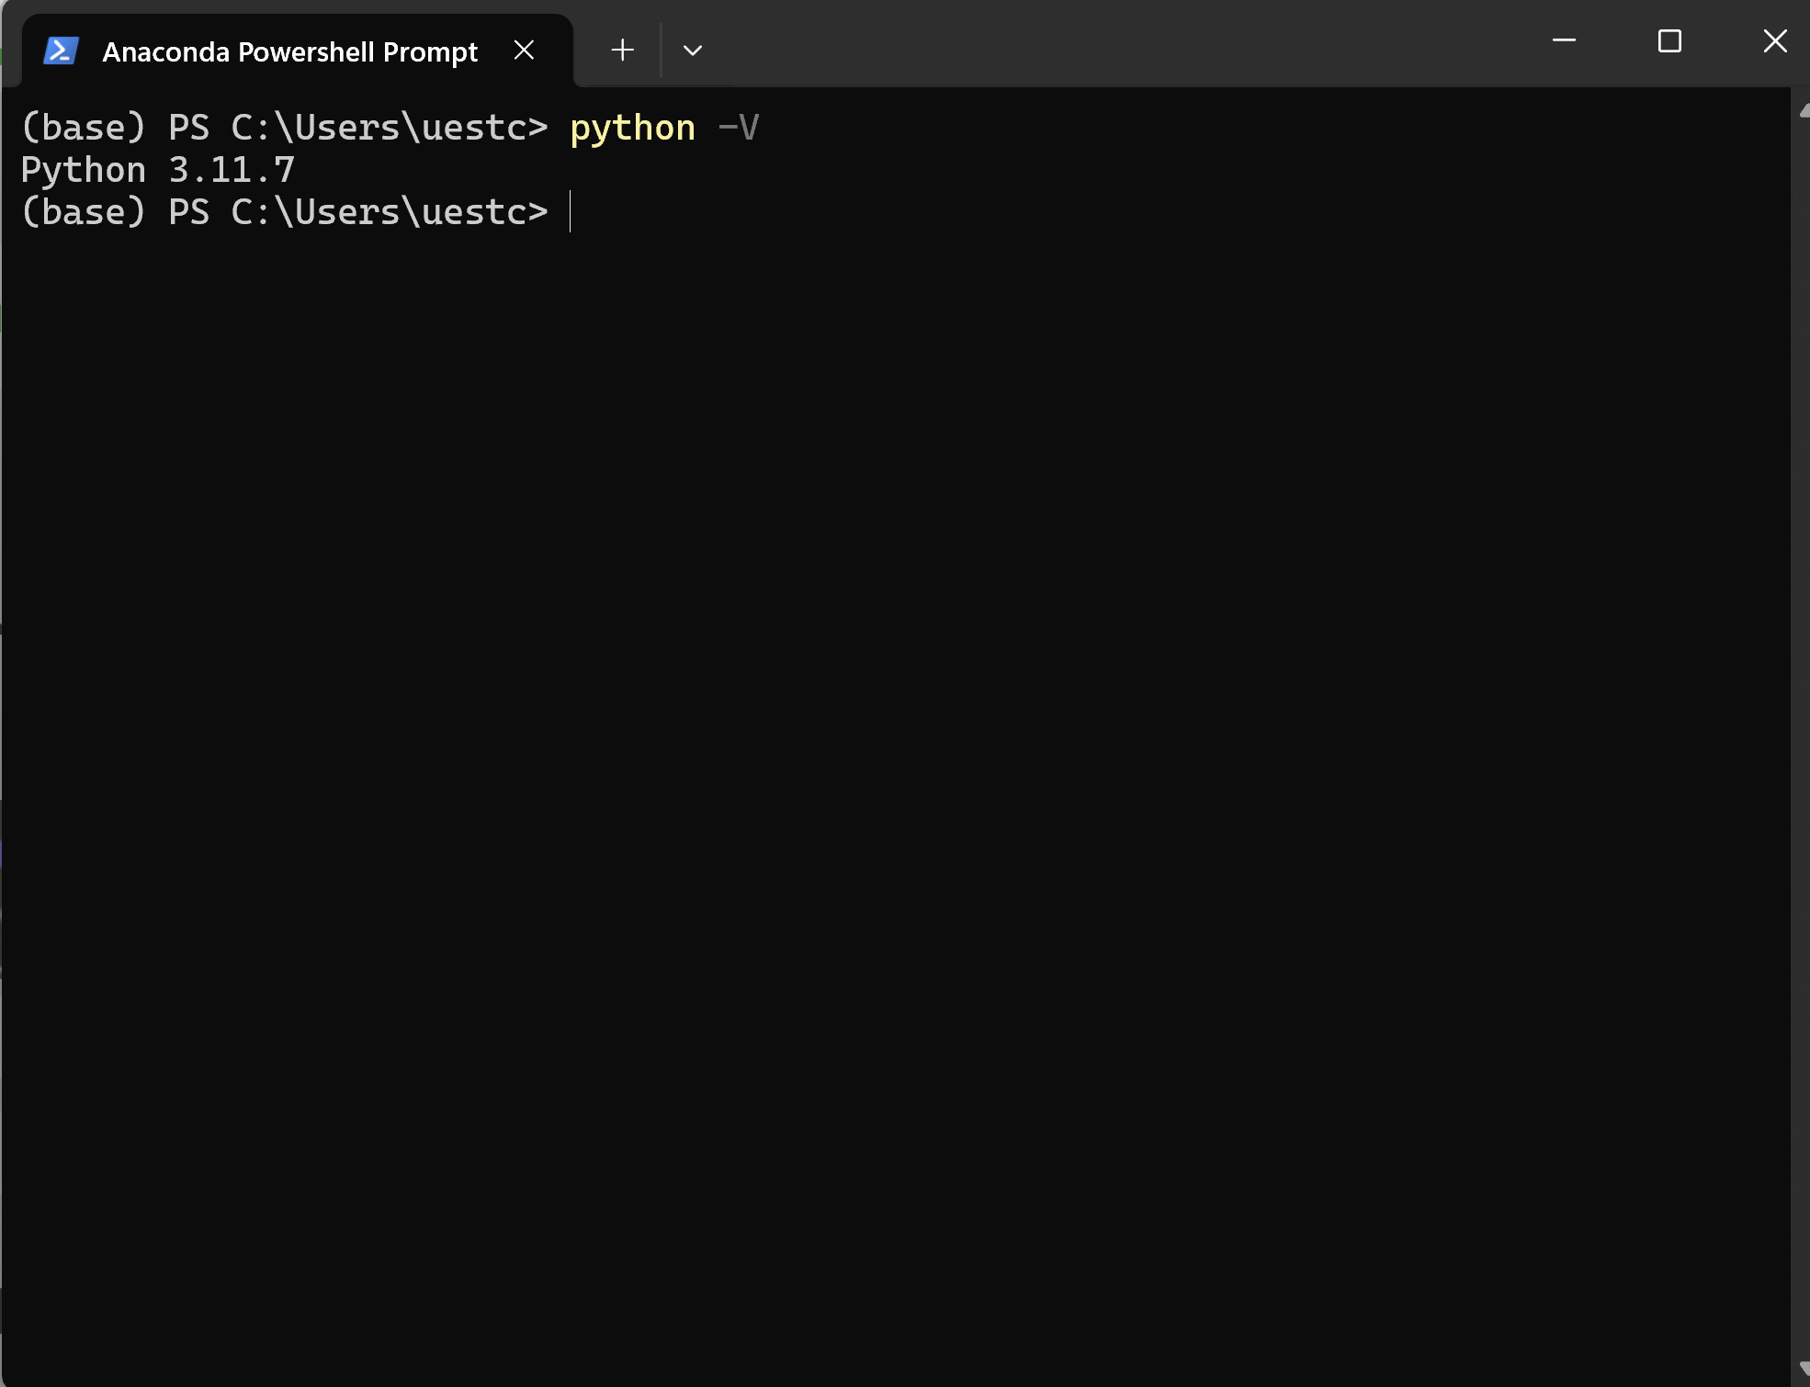
Anaconda install
默认安装python3.11.7
不同的anaconda 安装不同的python 版本

Slide 16
Anaconda install
Python with IDLE

Slide 17
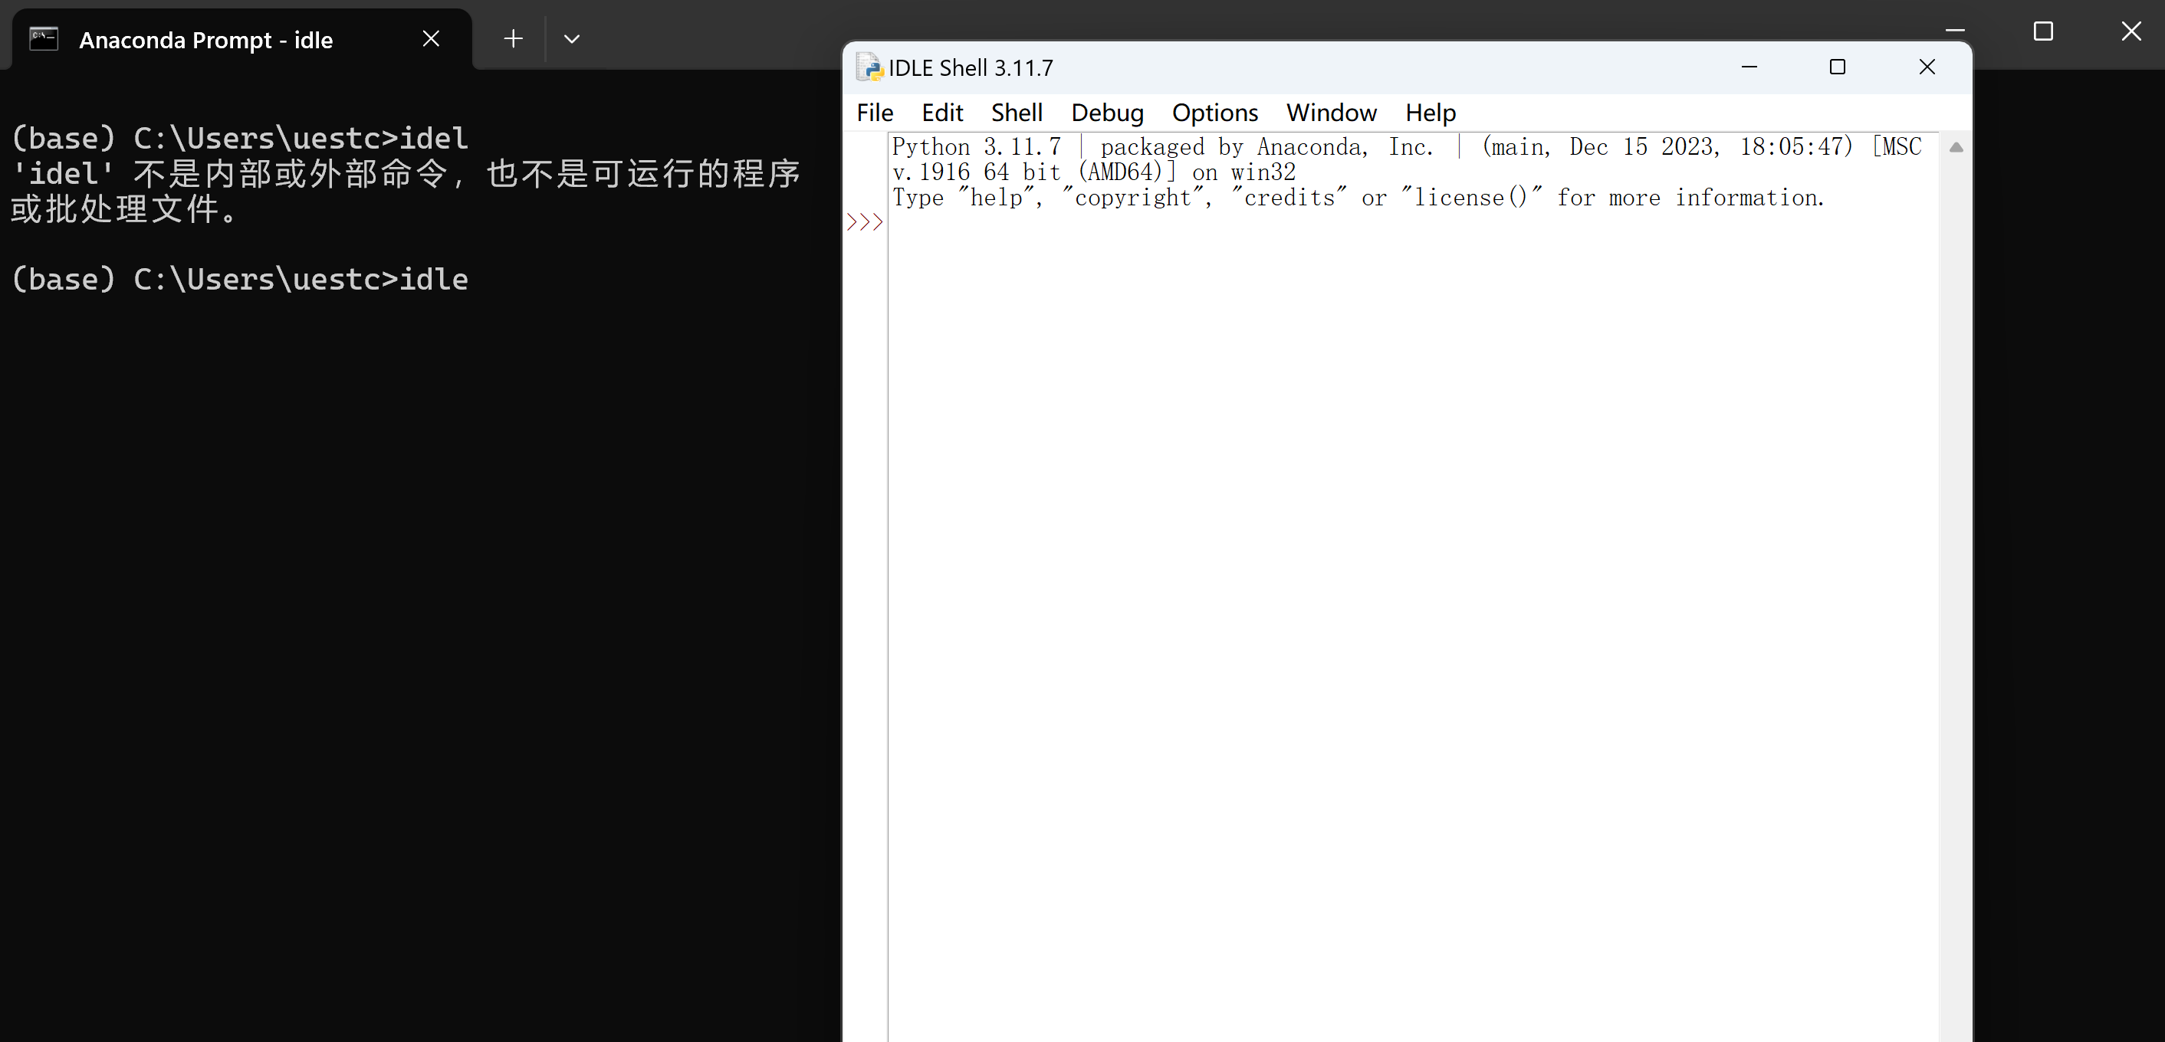
Anaconda install
Open idle

Slide 18
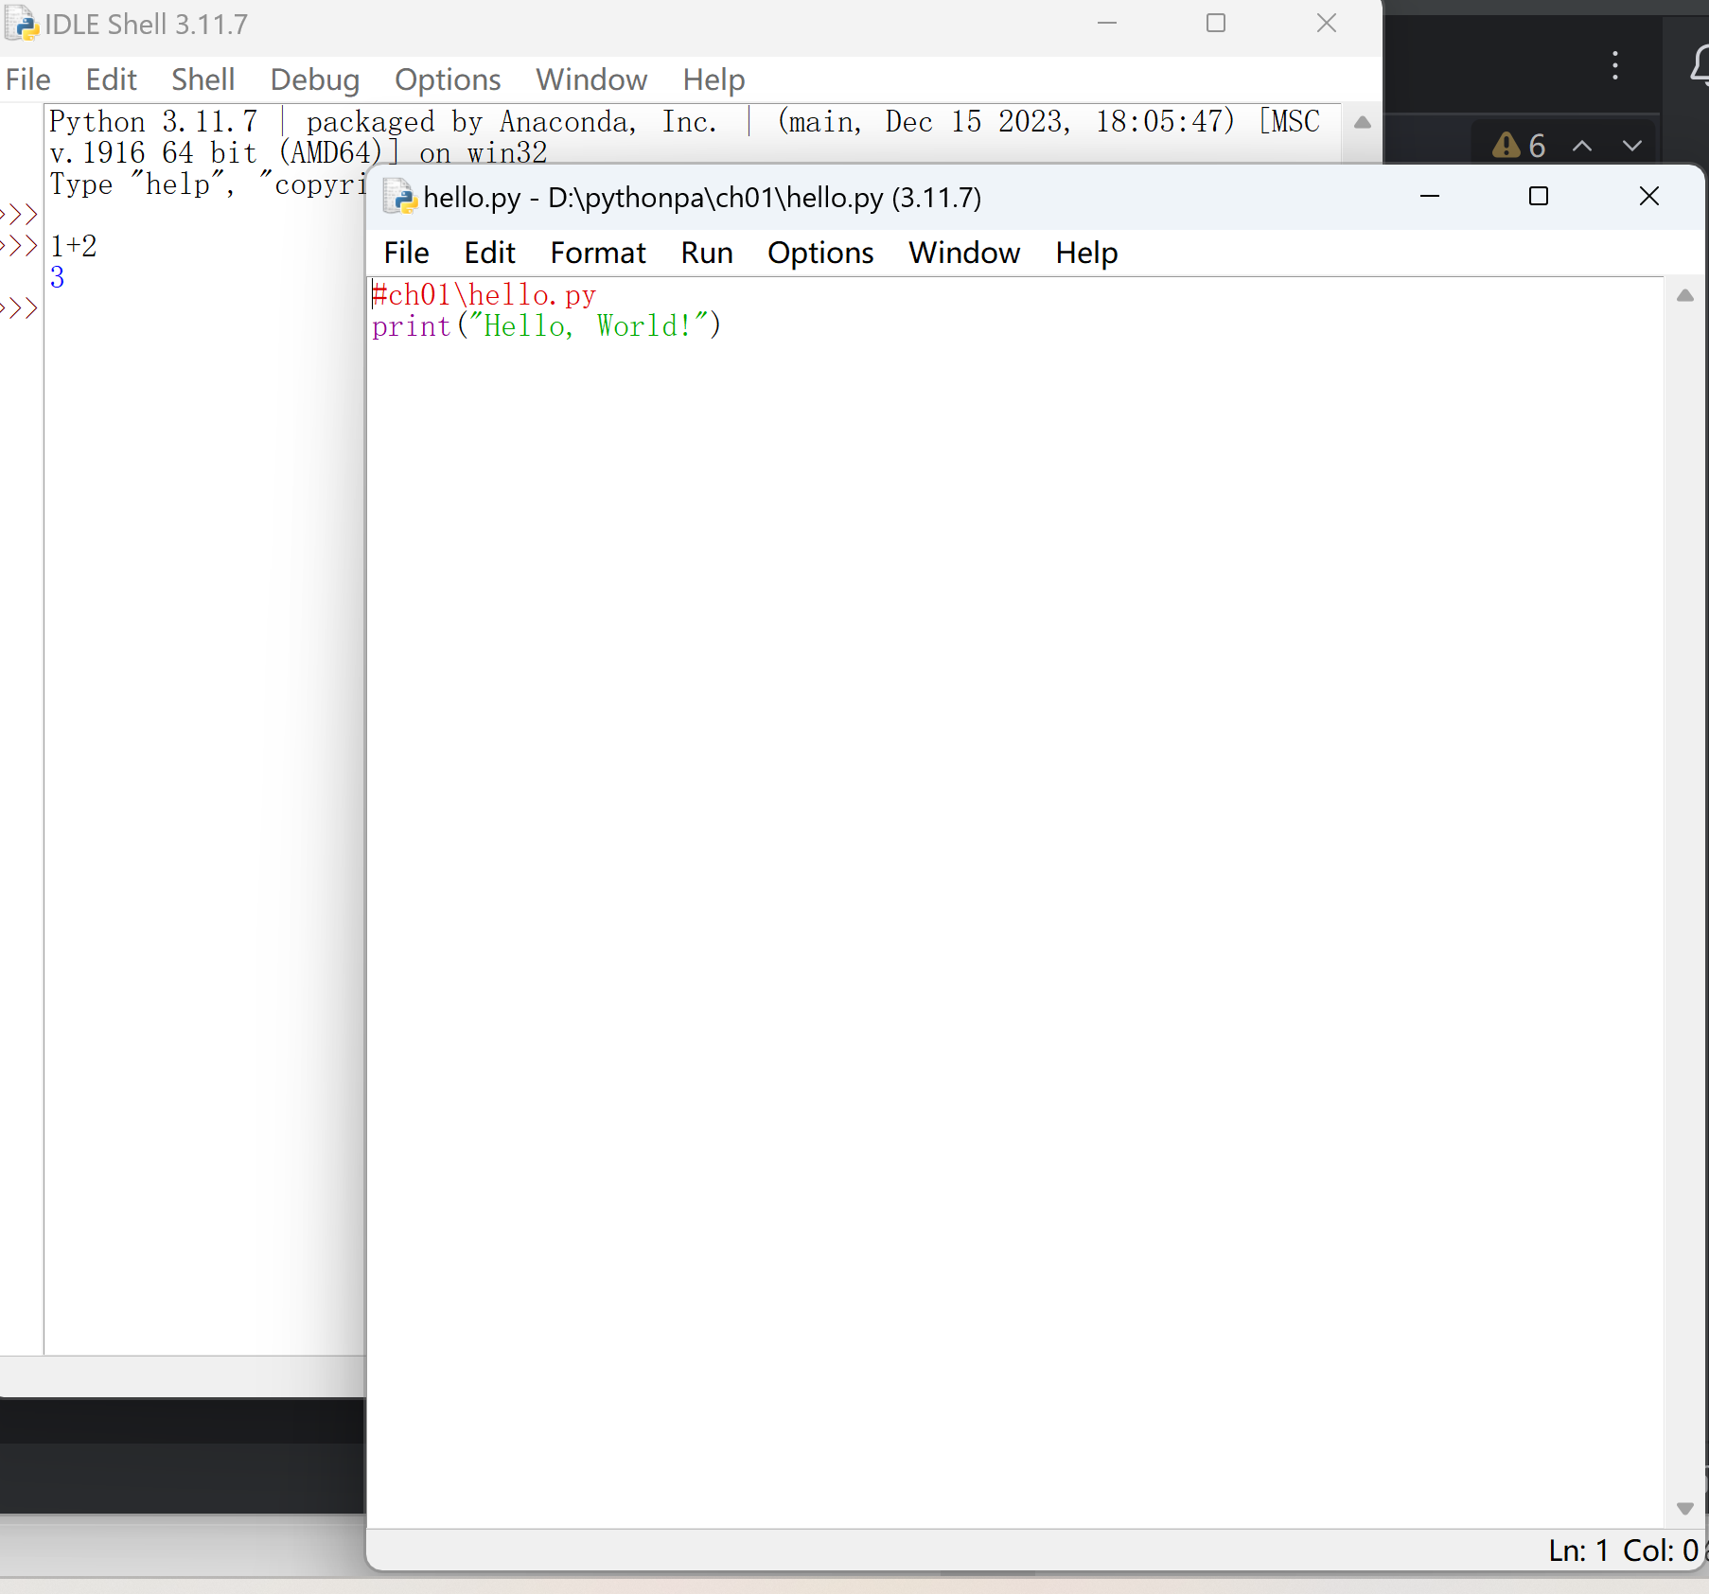
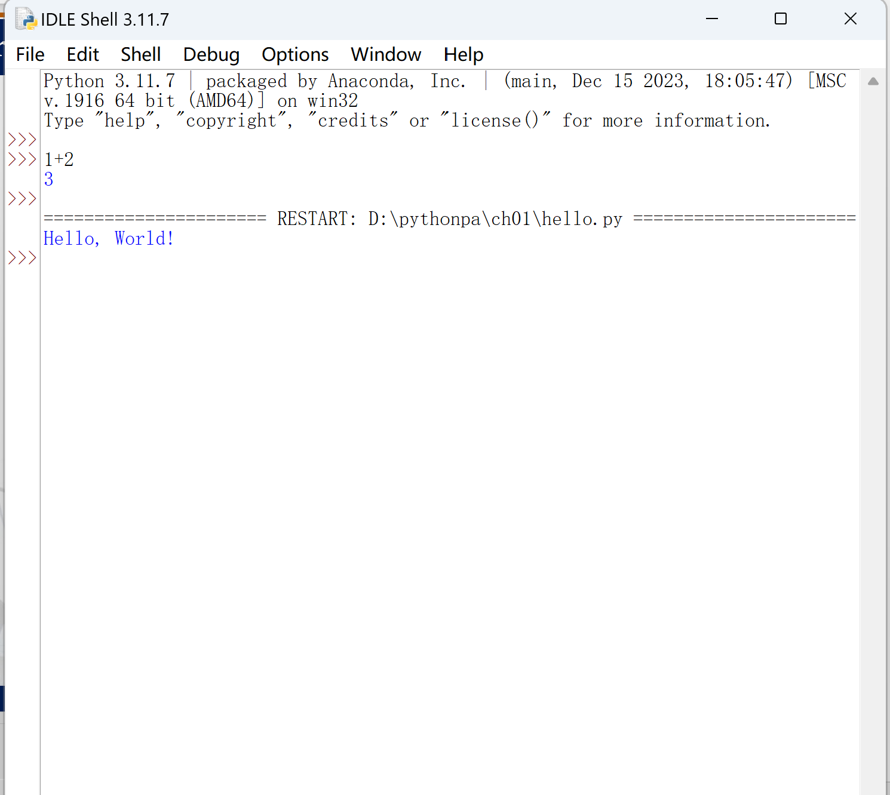
Anaconda install

Slide 19
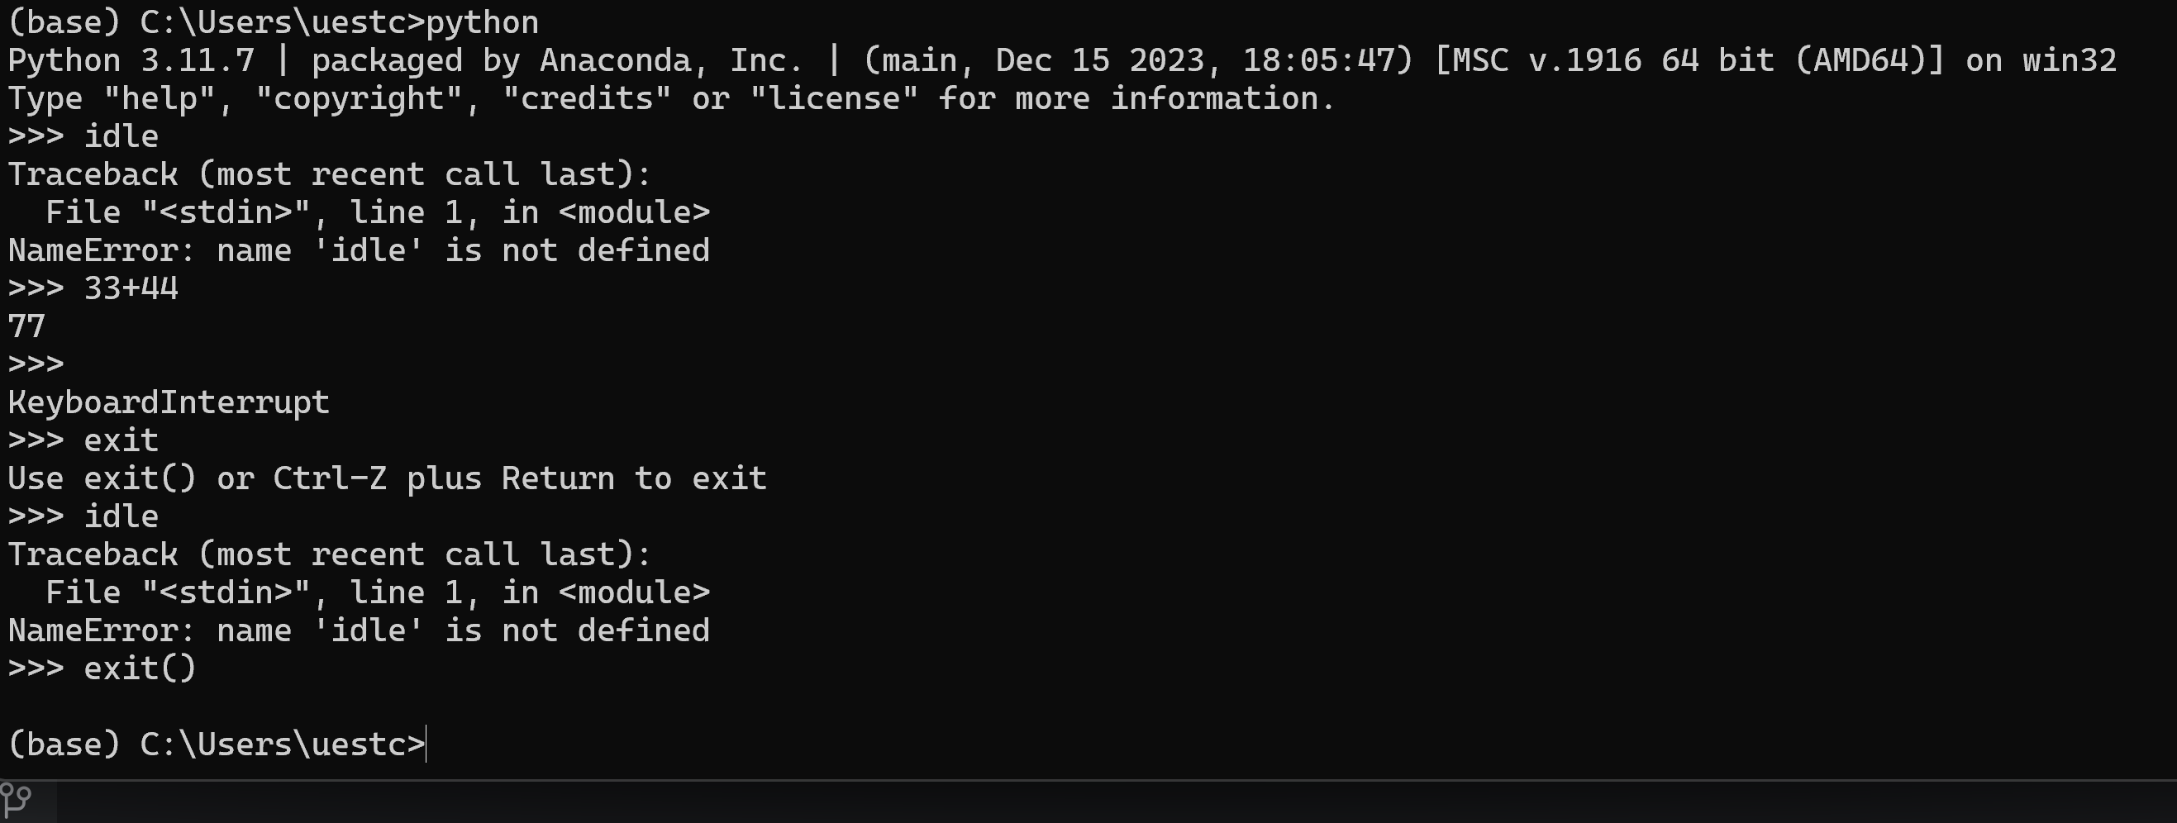
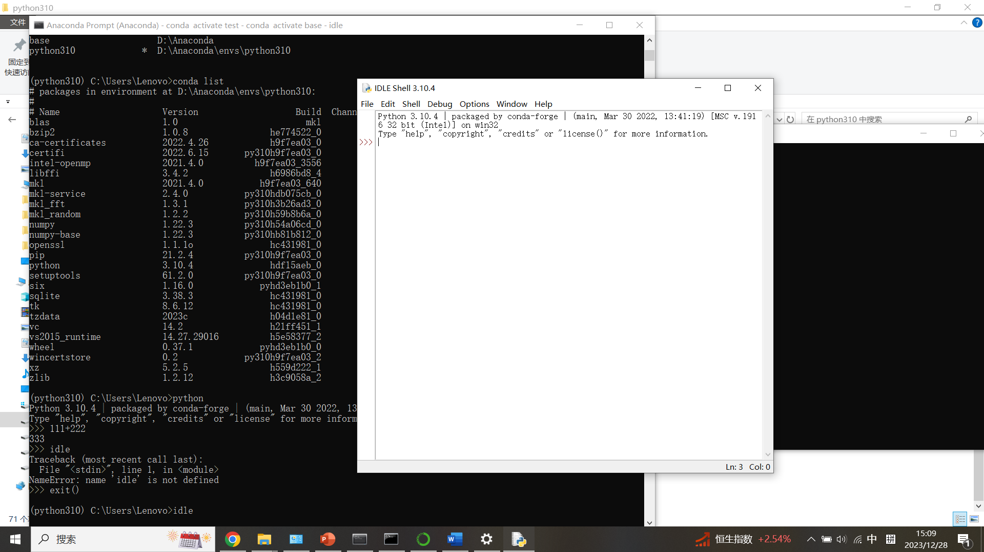
Anaconda install

Slide 20
Anaconda install
Online help and related resources

Slide 21
Online help and related resources
Python Interactive Help System
Type the help() function directly to access the interactive help system.
Type help(object) to get help information about an object.
[Example ] Using the Python Interactive Help System Example
(1) Access the interactive help system. In the Python interpreter, type help(), press enter
(2) Display all installed modules. Type modules, then press enter.
(3) Display the modules associated with random. Type modules random and press enter
(4) Display help information for the module random. Type random and press enter.
(5) Display information about the random function of the random module. Type random.random, then press the Enter key
(6) Exit the help system. Type quit, then press enter.

Slide 22
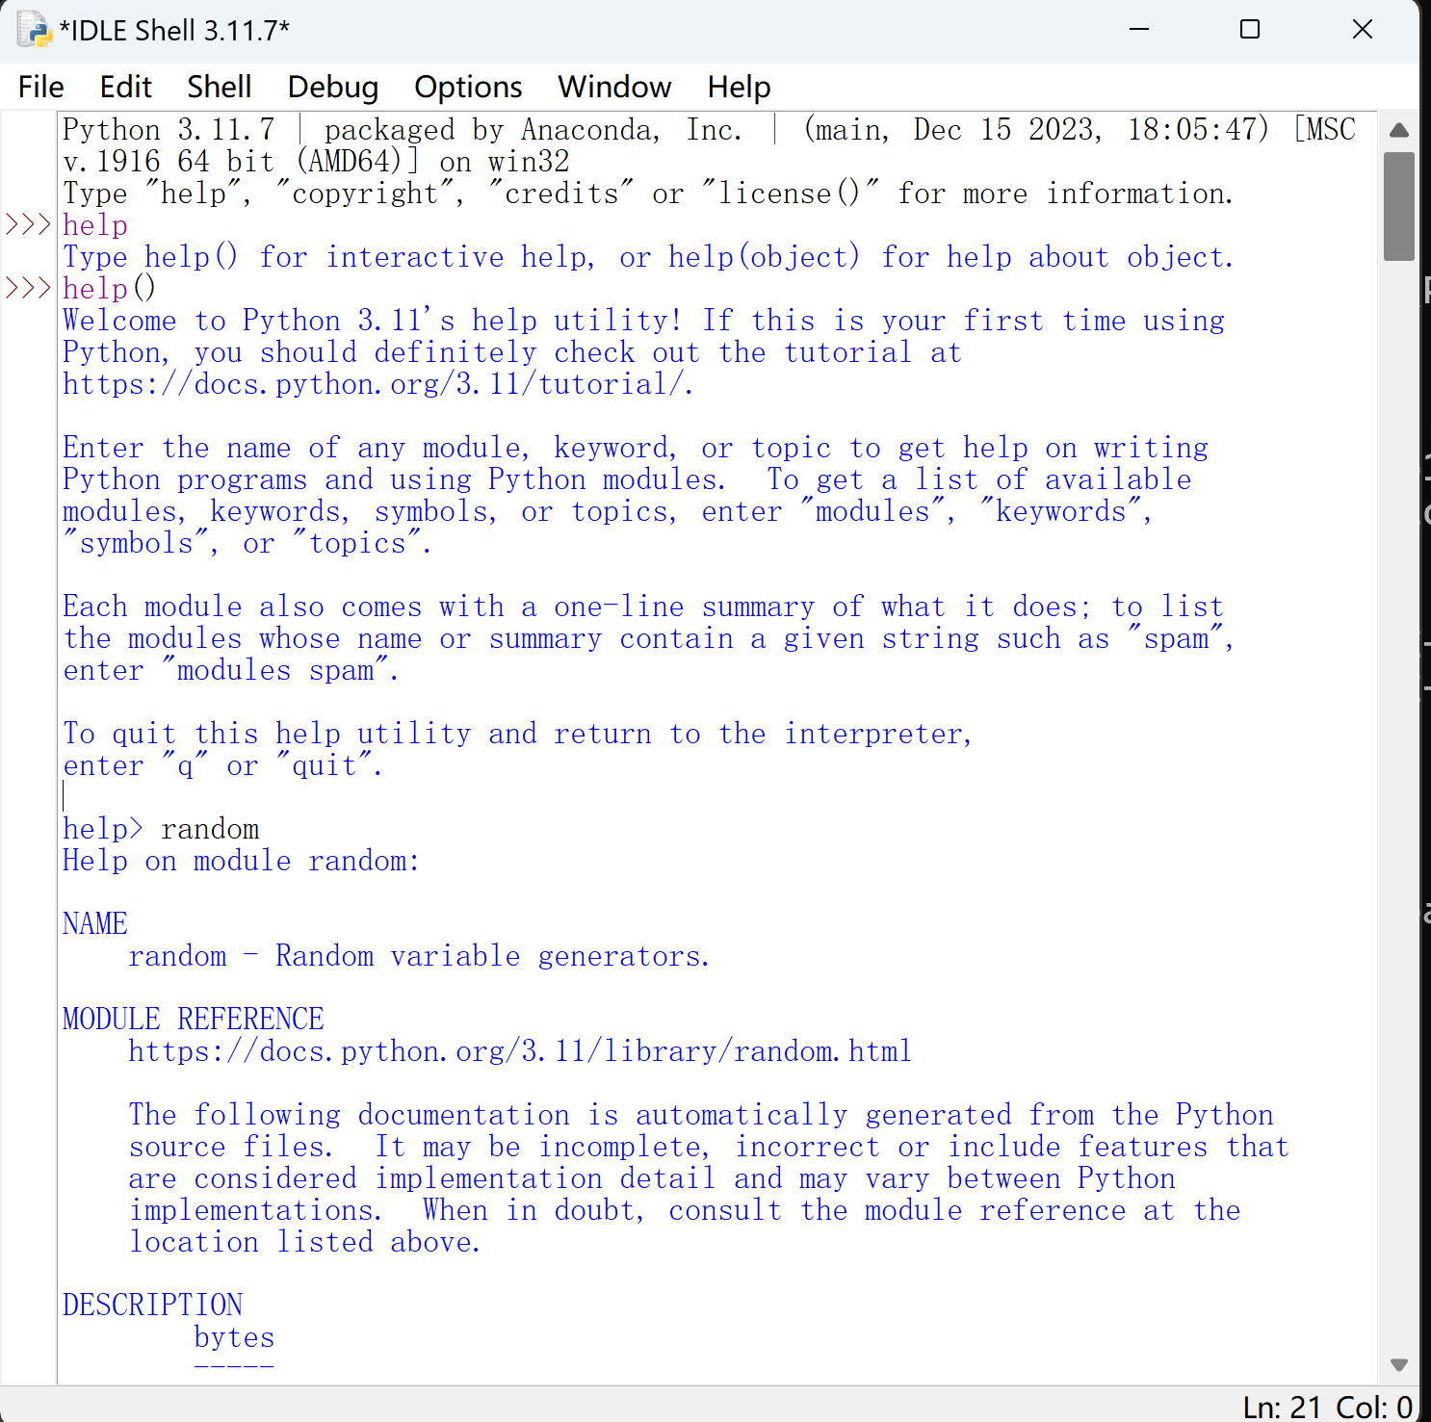
Online help and related resources

Slide 23
Online help and related resources
[Example ] Using Python's Built-in Functions to Get Help Information
(1) View the list of Python built-in objects. Enter the command: >>>> dir(__builtins__)
(2) View information about float. Enter the command: >>> float
(3) Check the help information of the built-in class float. Enter the help(float) command.
Python Documentation: Detailed reference information on the Python language and standard modules.
[Example ] Using Python Documentation
(1) Open the Python documentation. Execute the Windows menu command "Start" | "All Applications" | Python 3.10 | Python 3.10 Manuals (64-bit) (Users can also press the F1 key in the IDLE environment) to open the Python documentation
(2) Browse the random module help information. Expand the catalog tree on the left to browse the random module's help information.
(3) Find help information about math. Click on the Search tab on the left, type math, then press Enter and double-click in the directory tree on the left to see help on math.

Slide 24
Online help and related resources
Python official website: https://www.python.org/
Users can download various versions of Python programs or view help files, etc.
Python Extended Library Index (PyPI): https://pypi.python.org/
Everyone can download third-party libraries or upload their own libraries to PyPI. pyPI recommends using the pip package manager to download third-party libraries.

Slide 25
Online help and related resources
P E P
Python Enhancement Proposals (Python Enhancement Proposals, also translated as Python Improvement Proposals)
PEP's official website is https://www.python.org/dev/peps/
A PEP is usually a formal document that summarizes information from multiple sources and is reviewed and approved by some of the core developers.

Slide 26
Online help and related resources
P E P
[Example ] PEP-0008: Python Coding Specification
The official website for PEP-0008 is https://www.python.org/dev/peps/pep-0008/
Users can learn about Python programming specifications
[Example ] PEP-0020: The Zen of Python
The official website for PEP-0020 is https://www.python.org/dev/peps/pep-0020/
Users can understand the guidelines for Python programming
Typing import this in the Python interpreter also outputs "The Zen of Python" as follows

Slide 27
Anaconda install
Packaging and distribution of programs

Slide 28
Packaging and distribution of programs
Python programs are most commonly packaged and distributed with the third-party extension package PyInstaller, which is used to generate Python source programs into directly runnable programs.
[Example] Installing the PyInstaller Package
In a Windows command prompt window, enter the command line command "pip install pyinstaller" to install the PyInstaller package

Slide 29
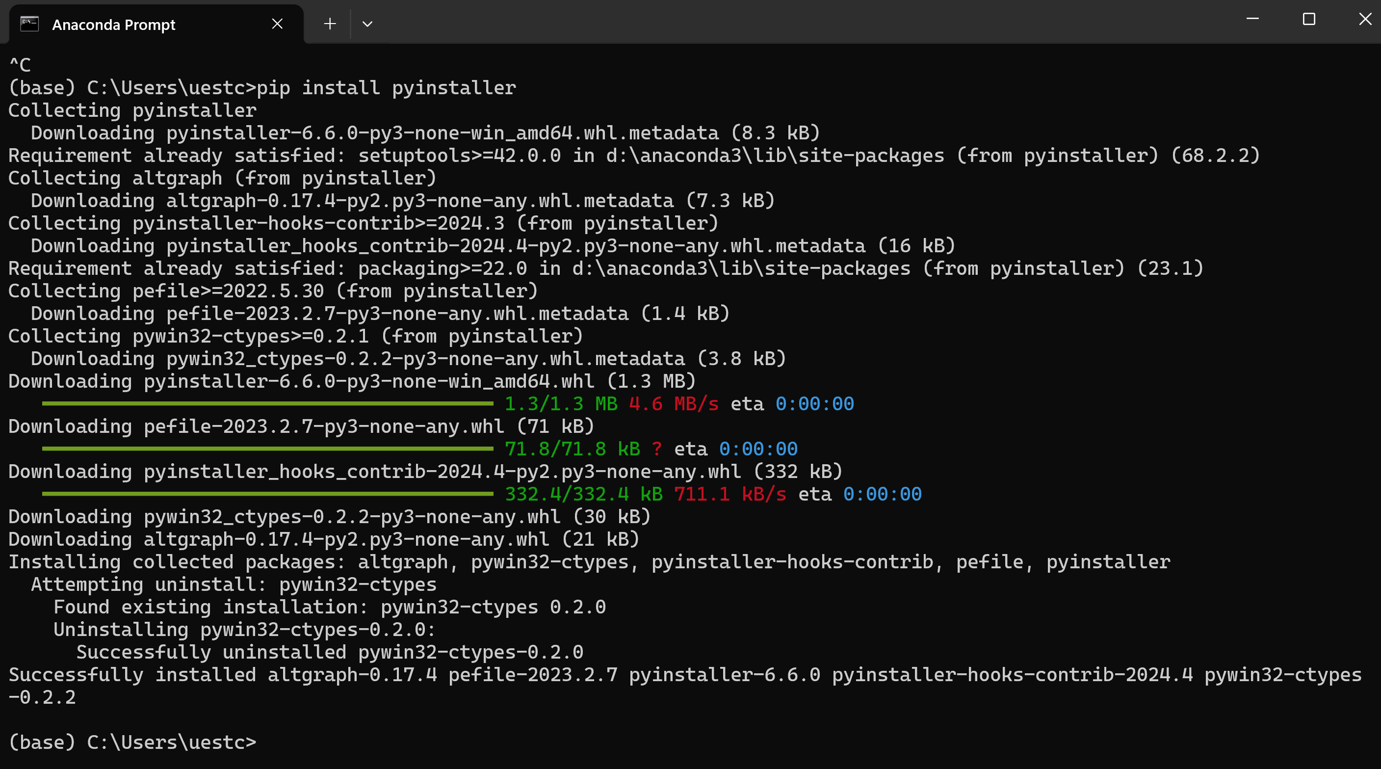
Packaging and distribution of programs

Slide 30
Packaging and distribution of programs
Generating Executable Programs with PyInstaller
pyinstaller Options Python Source Files
[Example] Using PyInstaller to Generate Executable Files
(1) Open a Windows command line window. In a Windows command prompt window, switch to the C:\pythonpa\ch01 directory.
(2) Generate an executable file.
Enter the command line command "pyinstaller -F hello1.py" to generate the executable file.
(3) Run the executable file.
Switch to the C:\pythonpa\ch01\dist directory, type "hello1.exe", press Enter to execute the program, and observe the result.

Slide 31
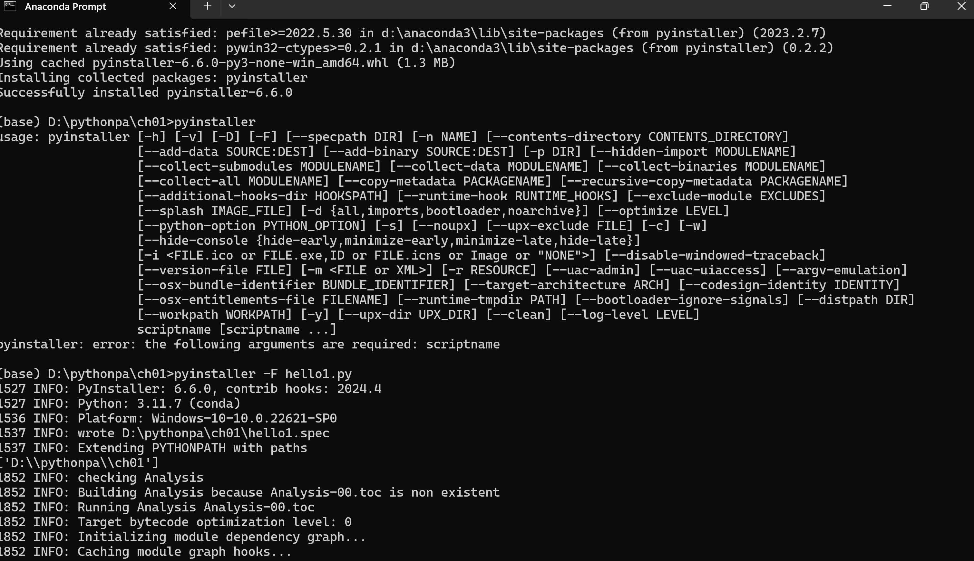
Packaging and distribution of programs

Slide 32
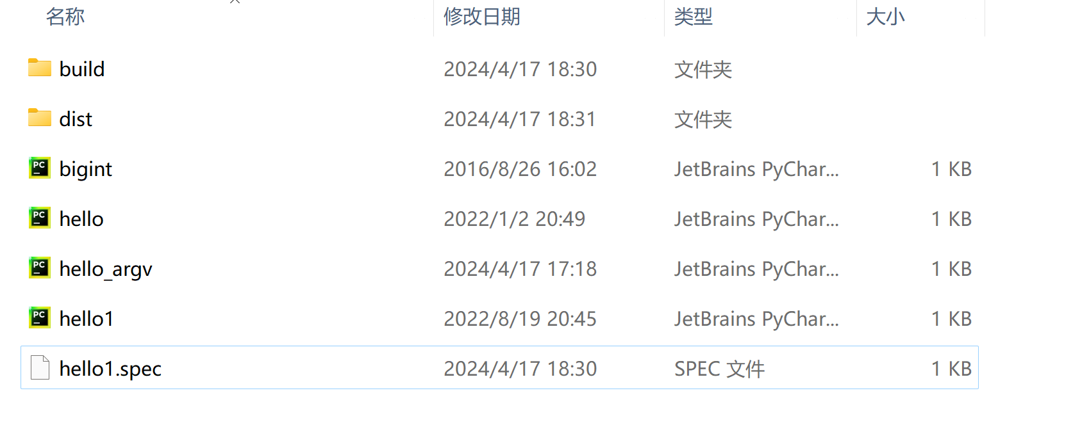
Packaging and distribution of programs

Slide 33
Anaconda install
Anaconda install other python version using commond. Such as: python3.10

Slide 34
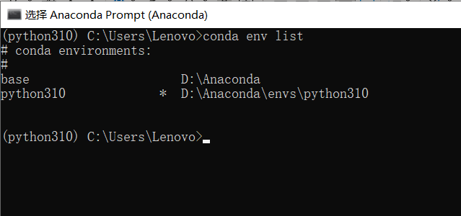
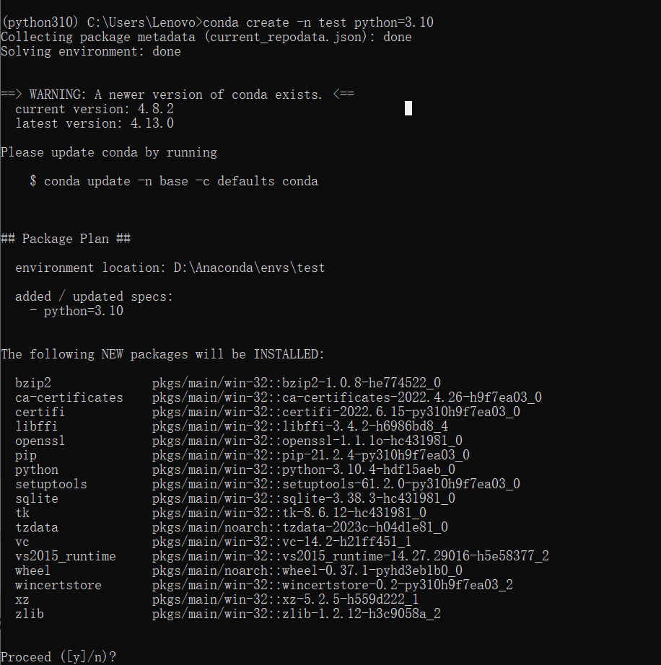
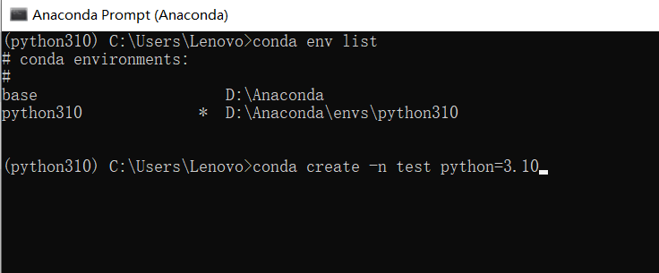
Anaconda install other python version. Such as: python3.10

Slide 35
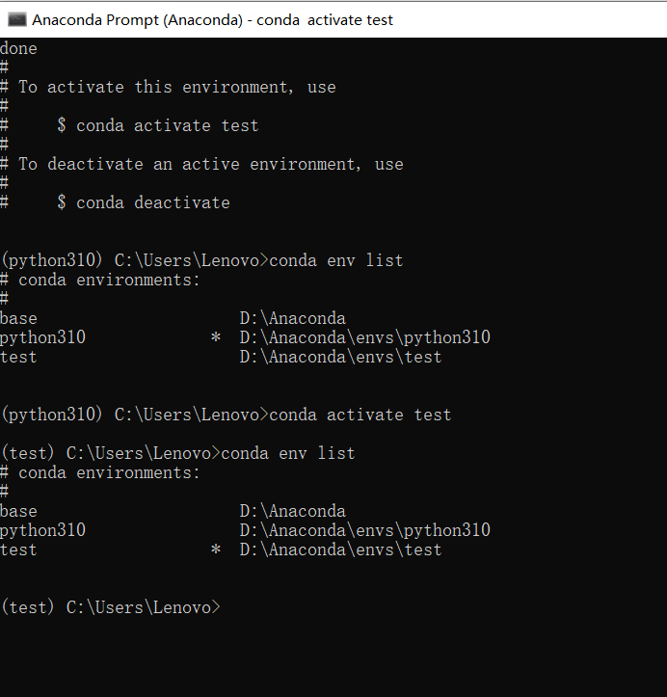
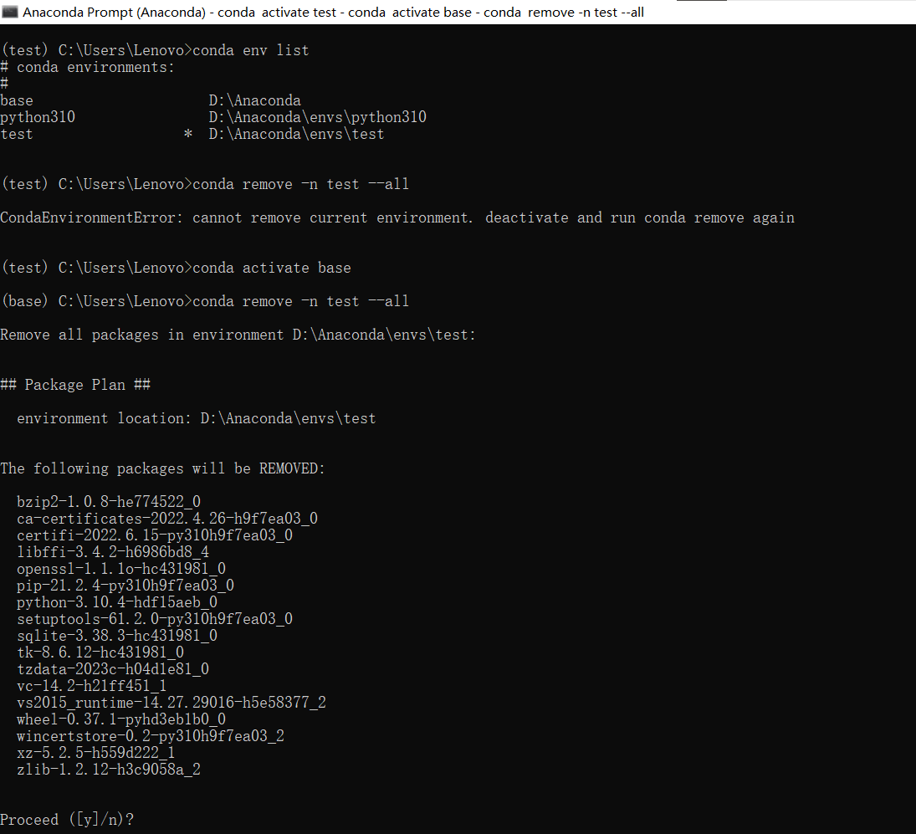
Anaconda install
Active conda environment

Slide 36
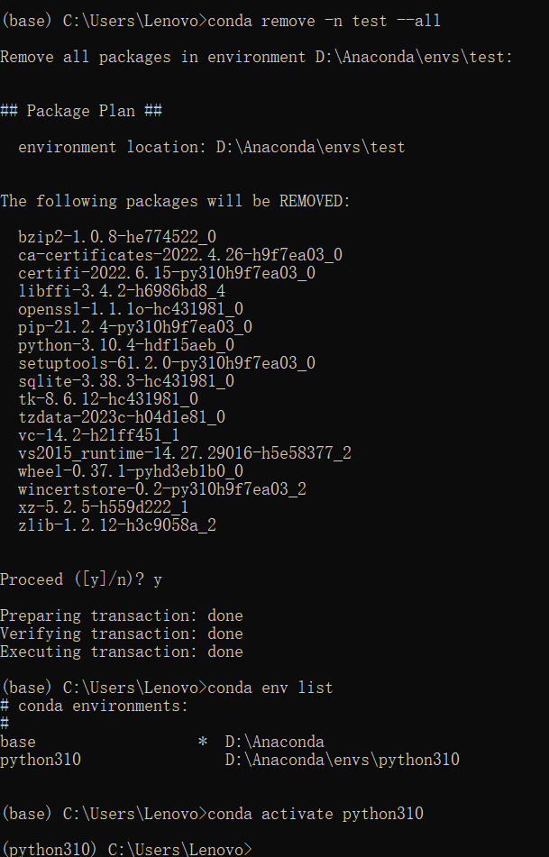
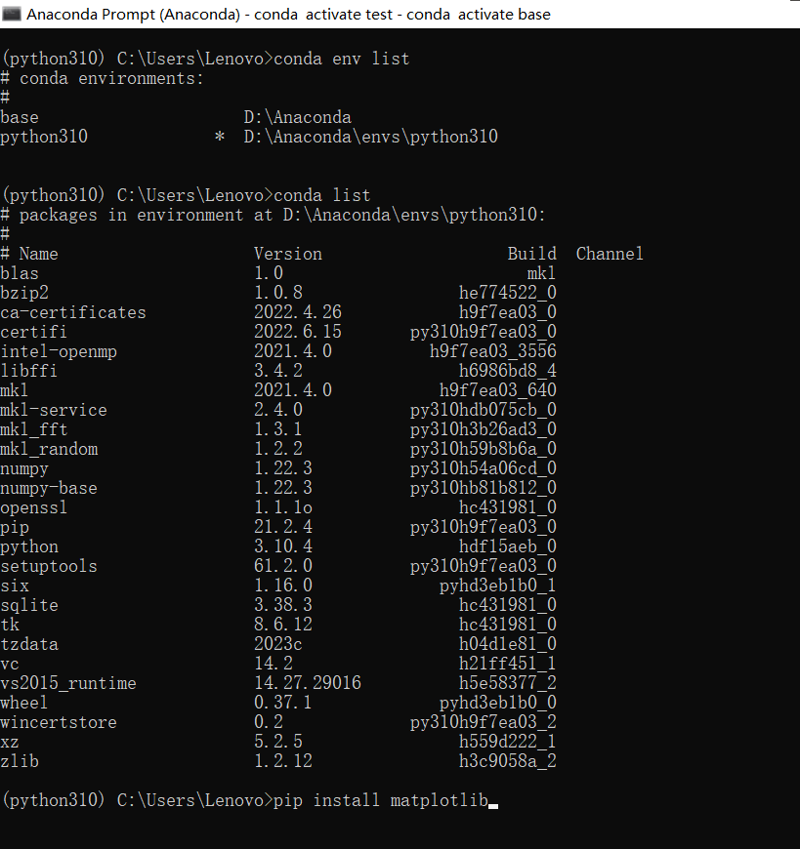
Anaconda install
Remove conda environment

Slide 37
Anaconda install
Anaconda install other python version using GUI. Such as: python3.10

Slide 38
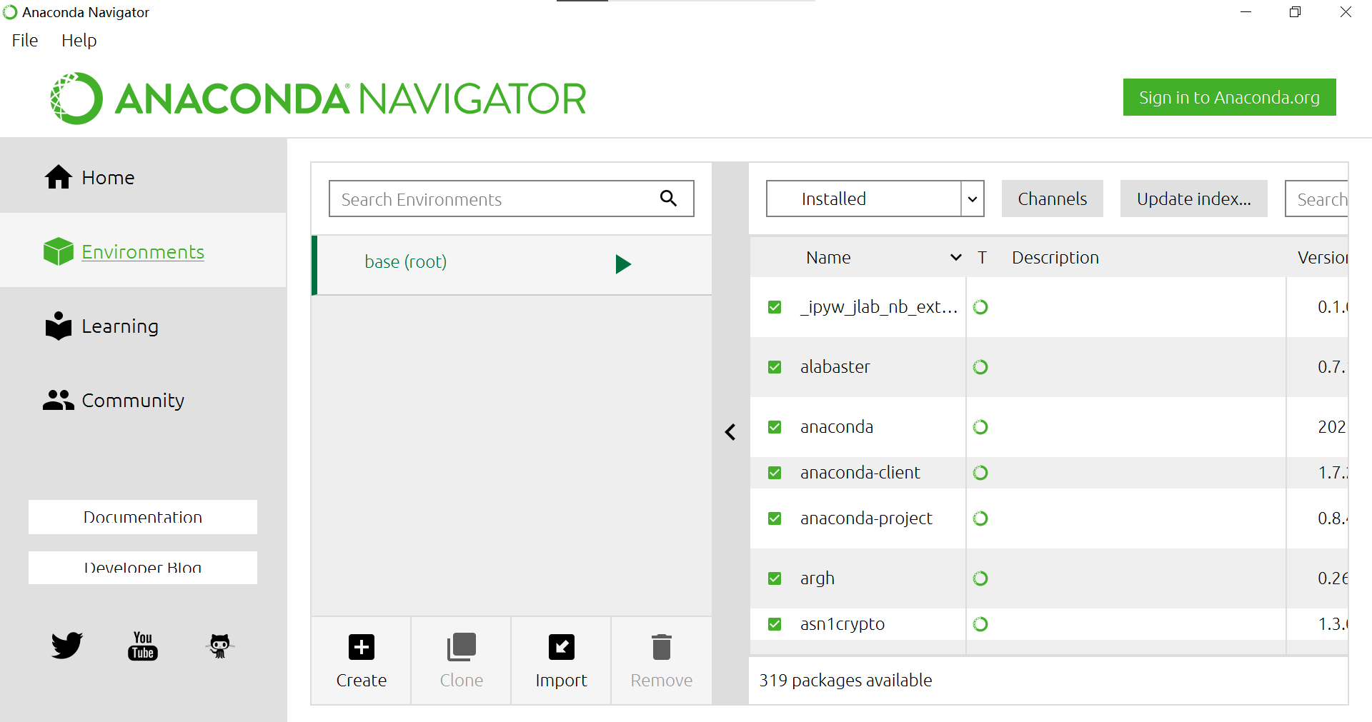
Anaconda install

Slide 39
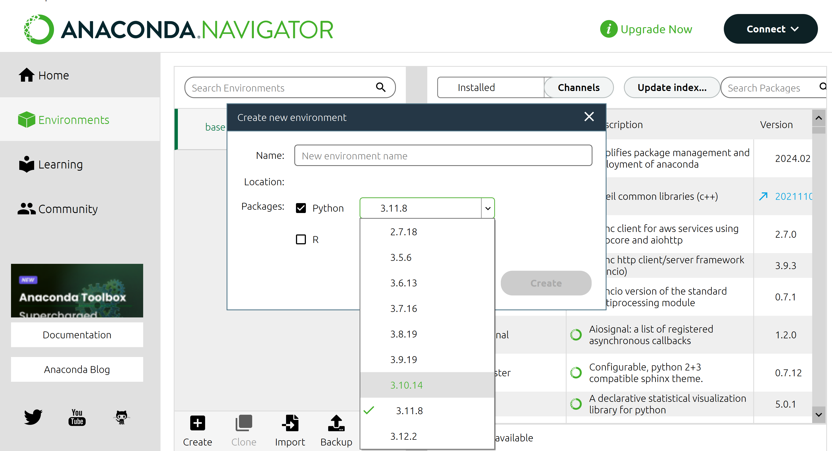
Anaconda install

Slide 40
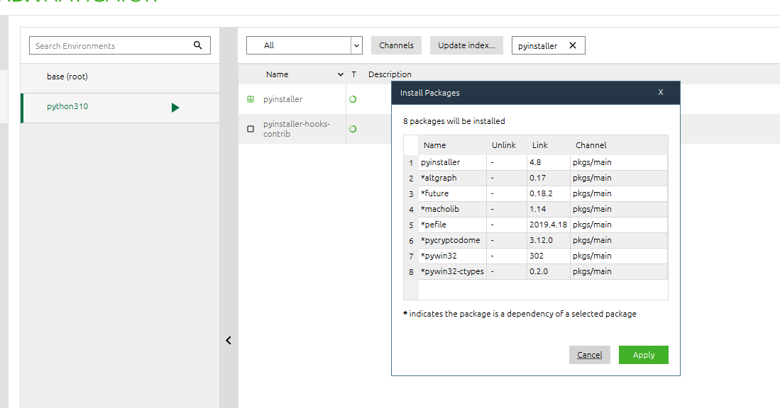
Anaconda install

Slide 41
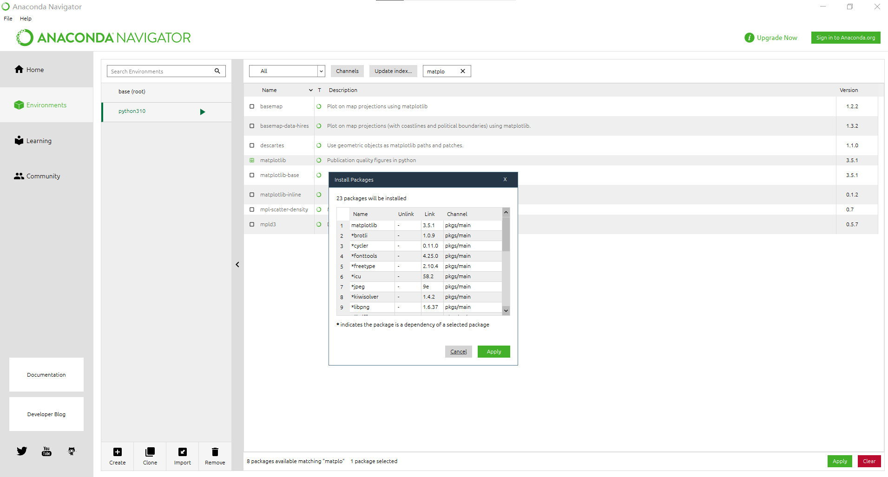
Anaconda install

Slide 42
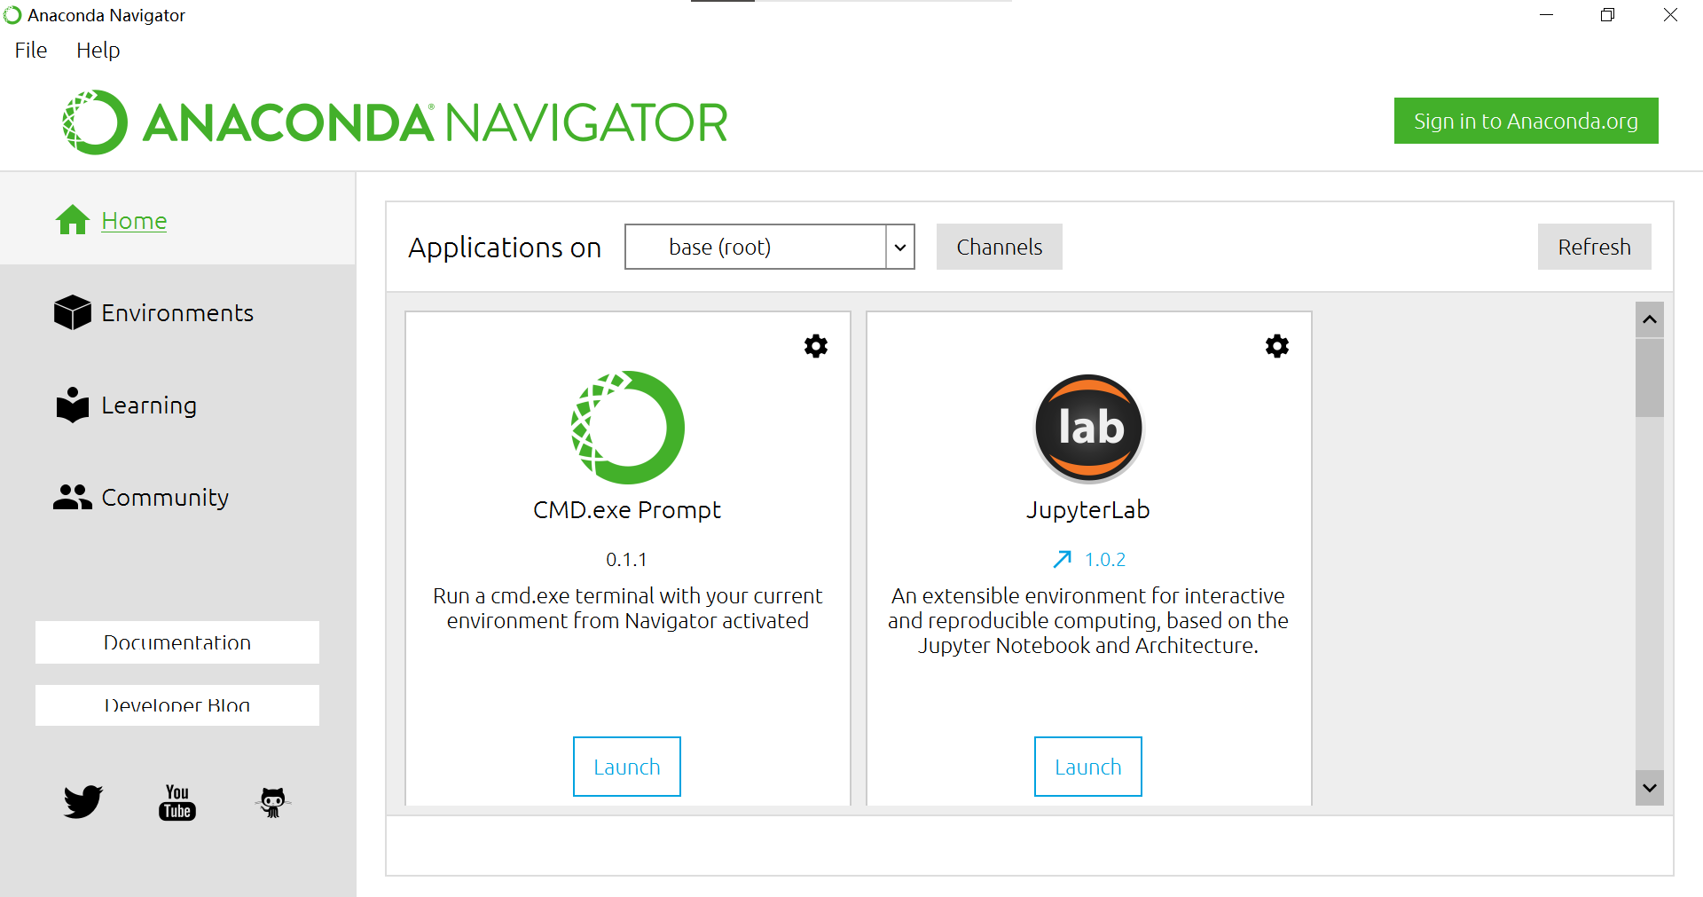
Anaconda install

Slide 43
PyCharm install
PyCharm install !!!

Slide 44
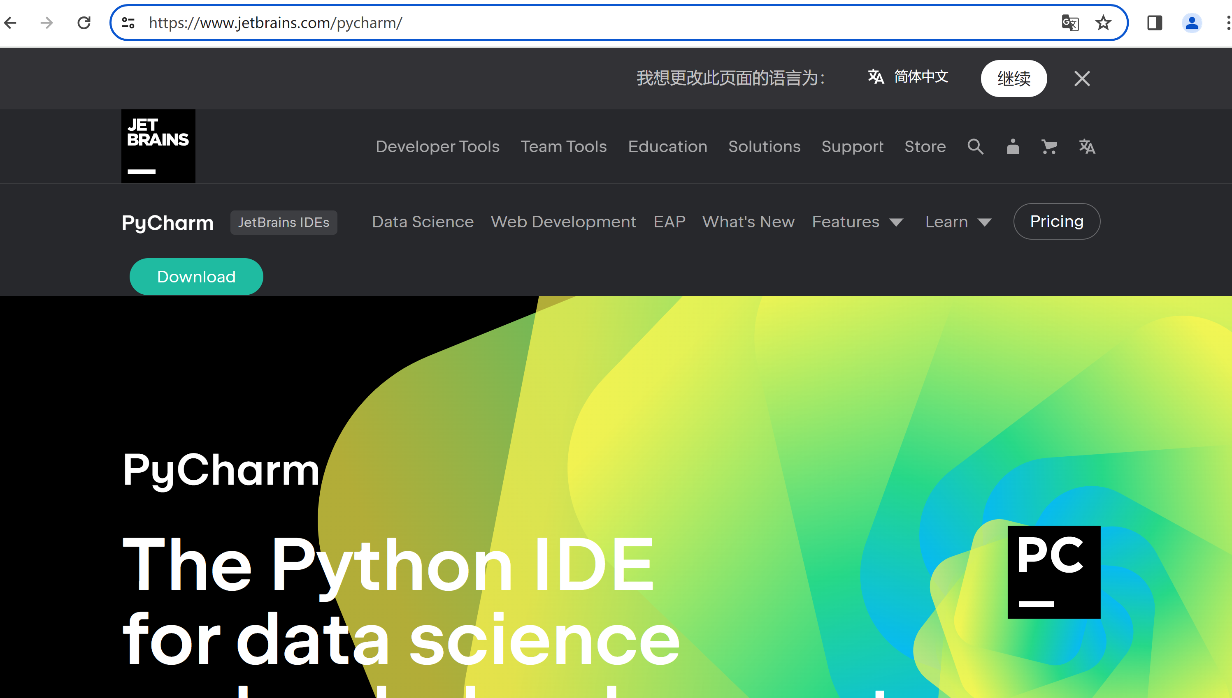
PyCharm install
https://www.jetbrains.com/pycharm/

Slide 45
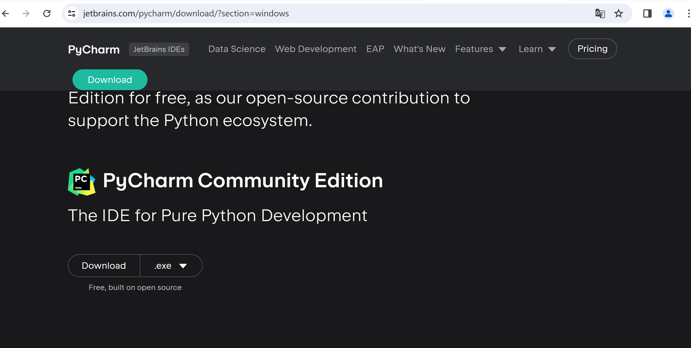
PyCharm install
https://www.jetbrains.com/pycharm/download/?section=windows

Slide 46
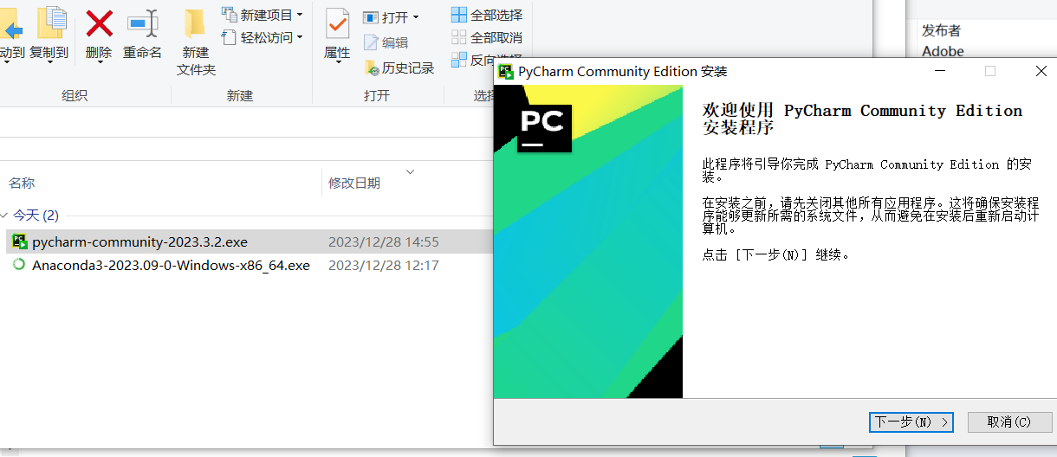
PyCharm install

Slide 47
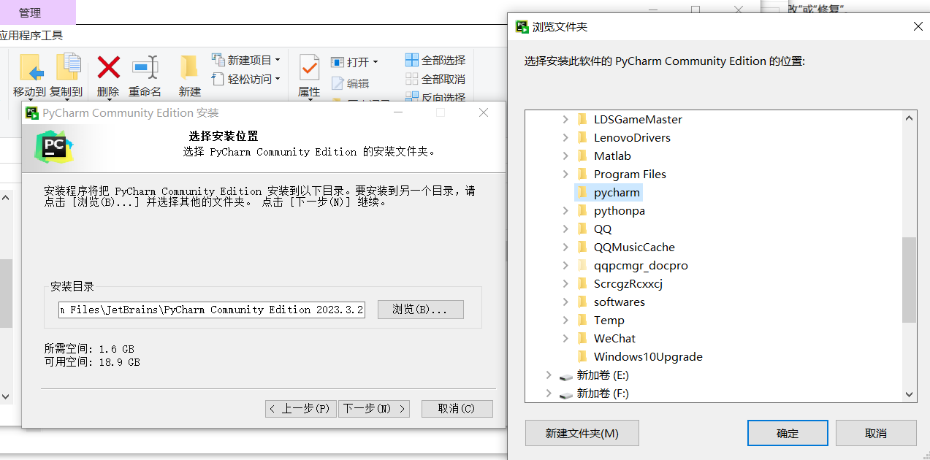
PyCharm install

Slide 48
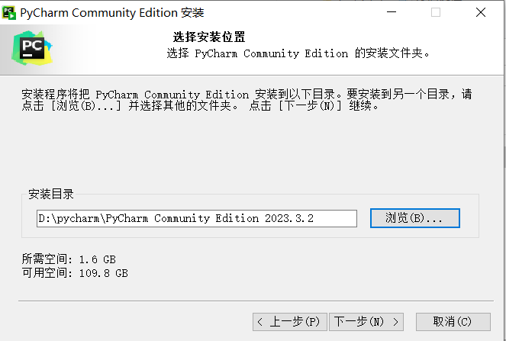
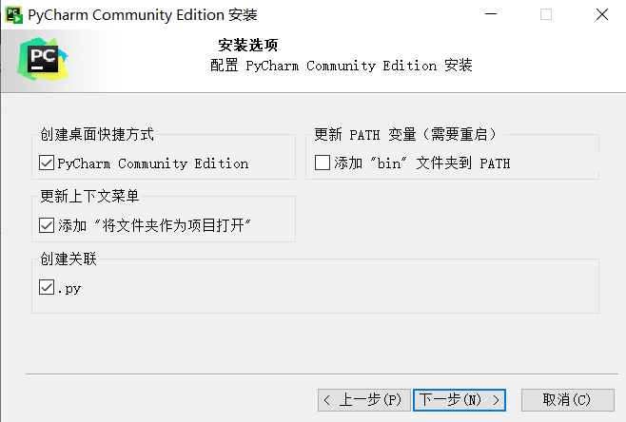
PyCharm install

Slide 49
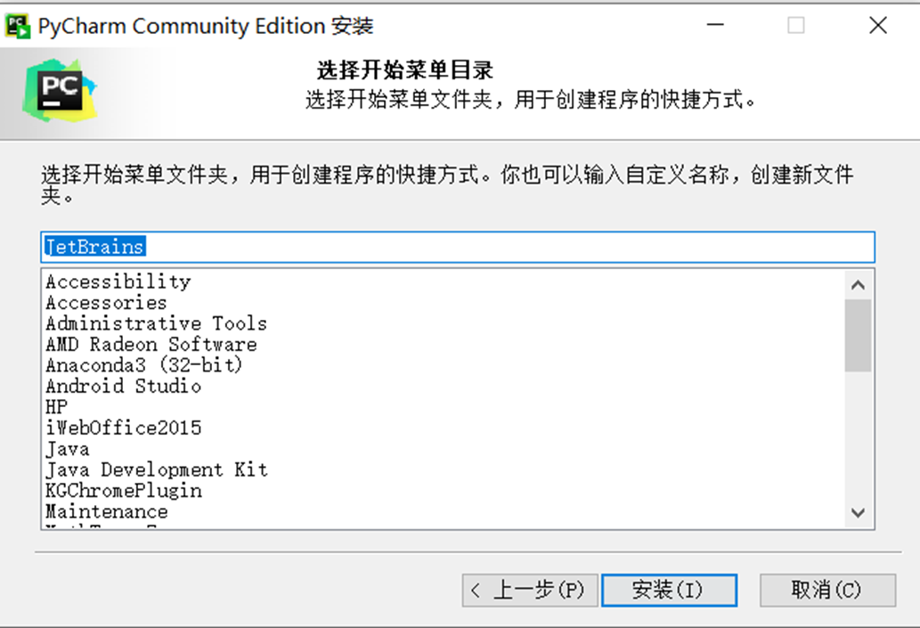
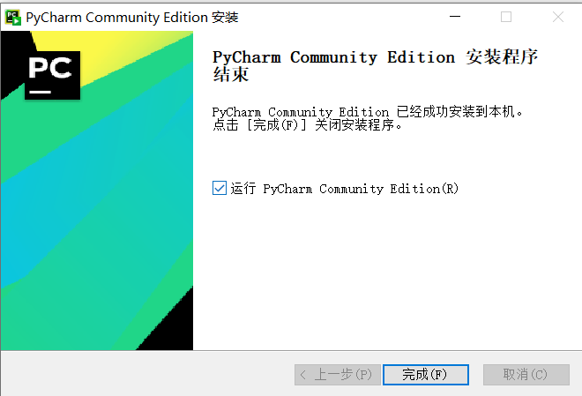
PyCharm install

Slide 50
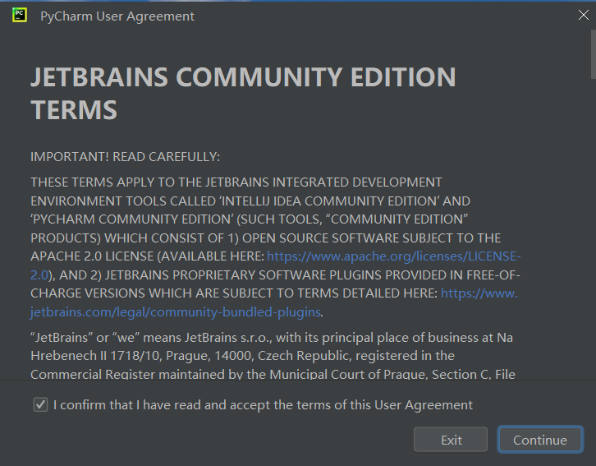
PyCharm install

Slide 51
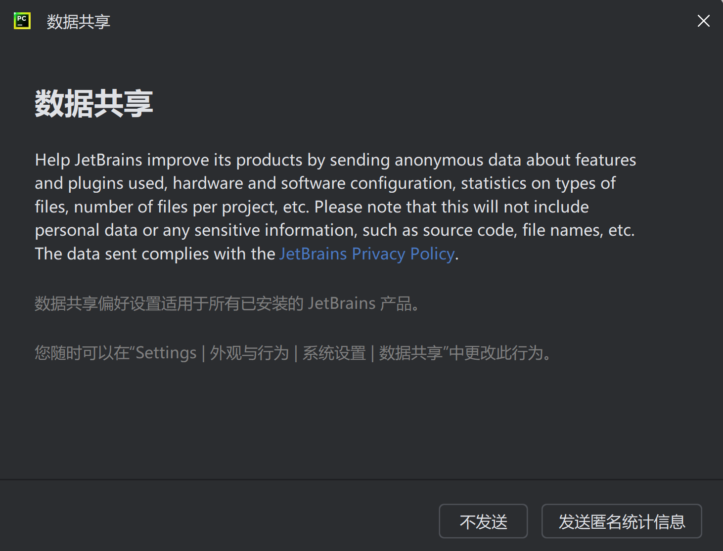
PyCharm install

Slide 52
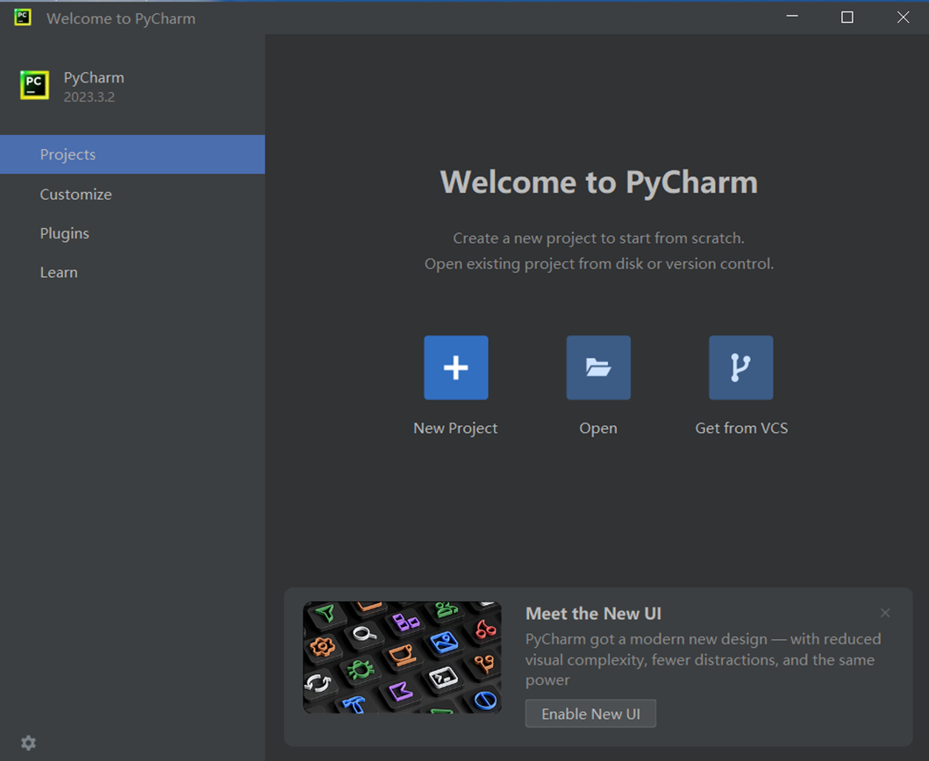
PyCharm interface

Slide 53
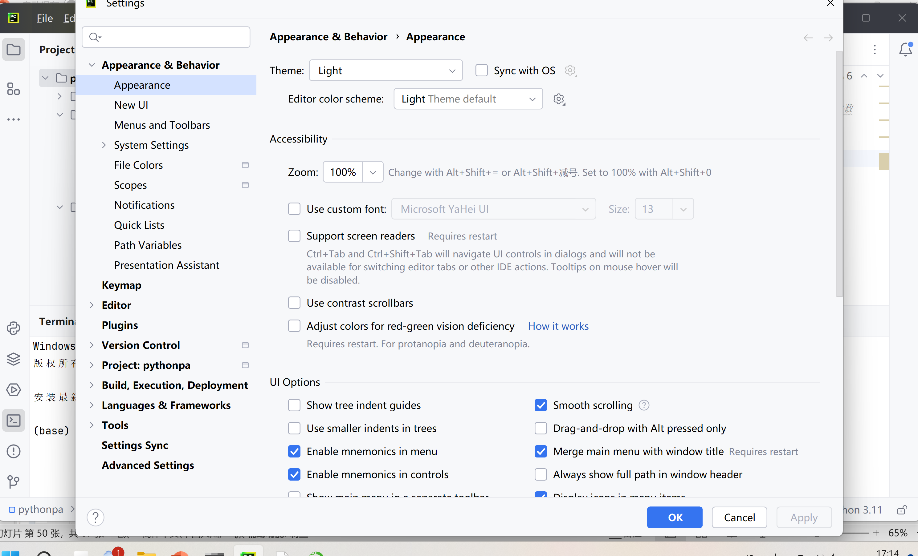
PyCharm interface

Slide 54
Using PyCharm
Using pycharm open original code

Slide 55
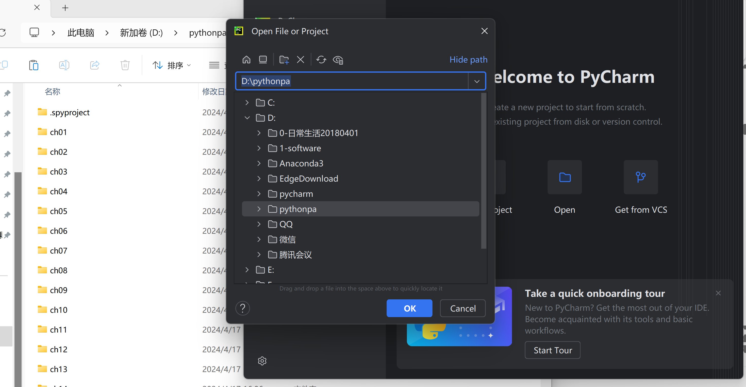
Using PyCharm
Using pycharm to open code

Slide 56
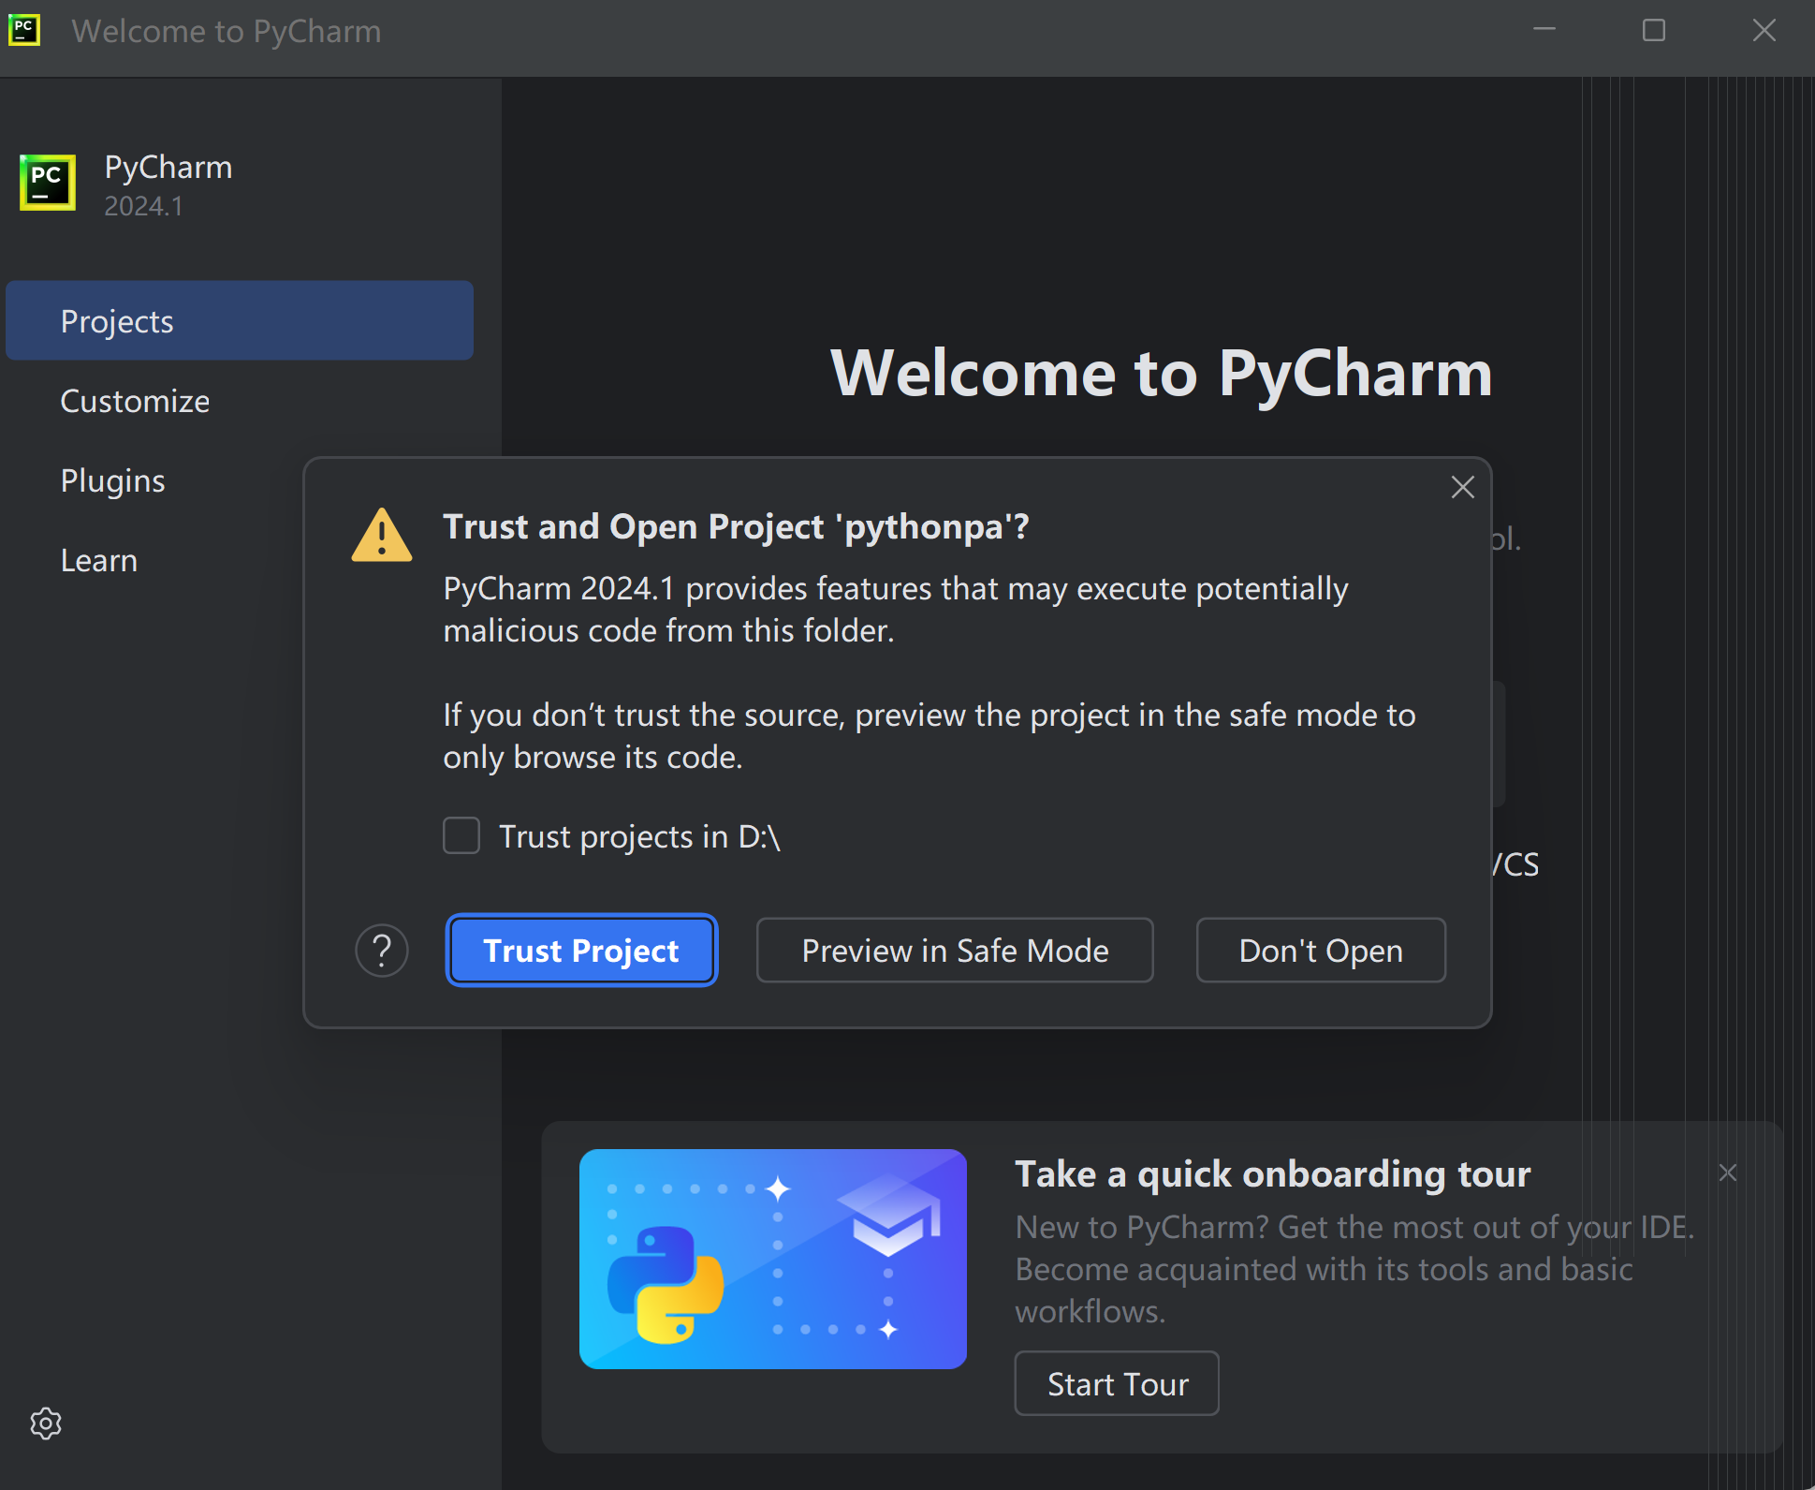
Using PyCharm

Slide 57
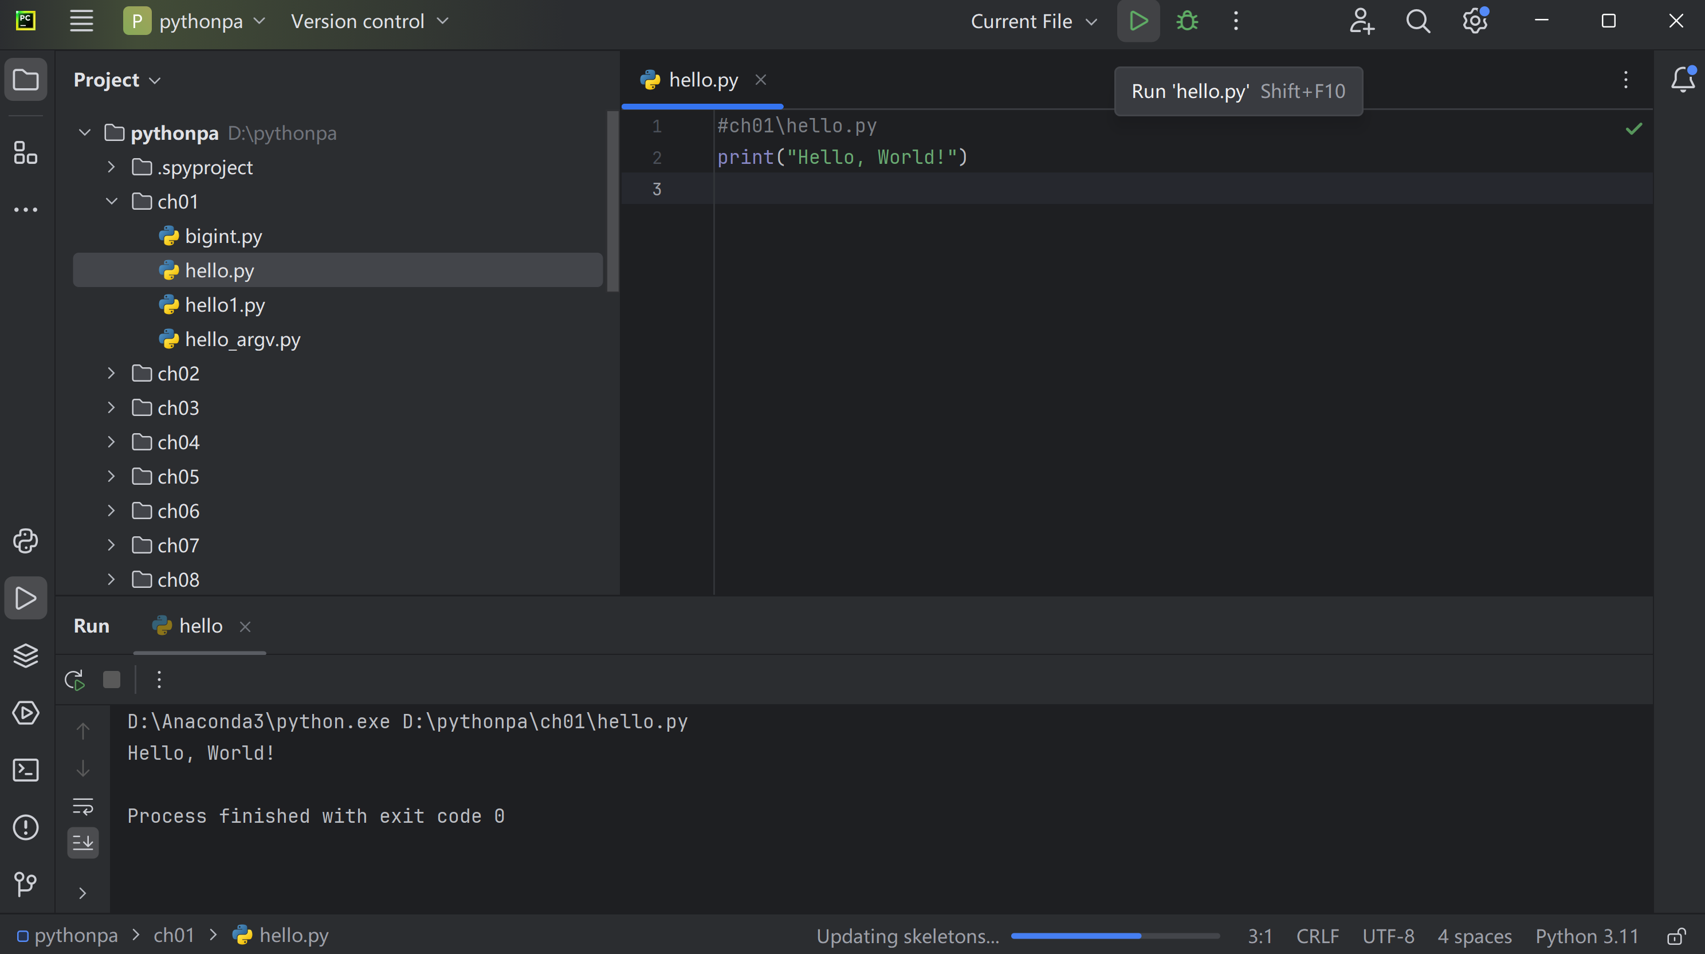
Using PyCharm
使用pycharm打开源代码

Slide 58
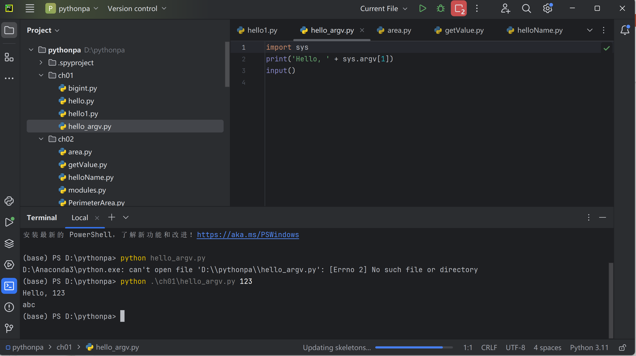
Using PyCharm

Slide 59
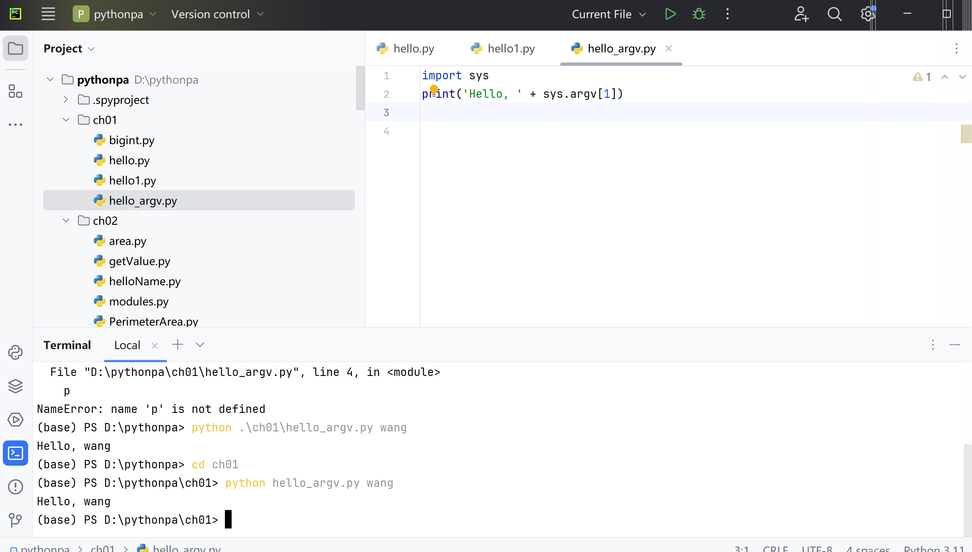
Using PyCharm

Slide 60

Using PyCharm

Slide 61

Using PyCharm

Slide 62

Using PyCharm

Slide 63

Thanks！
谢谢！

